Slide 1
Good Morning!!
Please claim a table for your “team”
Use the materials at the table to make your team’s name visible to other teams
(creativity is encouraged)
Notes:
Before beginning, get to know our audience:
Who is a developer/engineer, designer, project manager, other?
Who has been in a startup
Who works in an enterprise company → note that this is applicable here too and Jeff has a new book coming out
Who is a first time Codemash participant?
The spirit of Codemash is to learn something new, try things outside of your comfort zone. We’re going to do that today and have fun too.

Slide 2
Intro

Slide 3
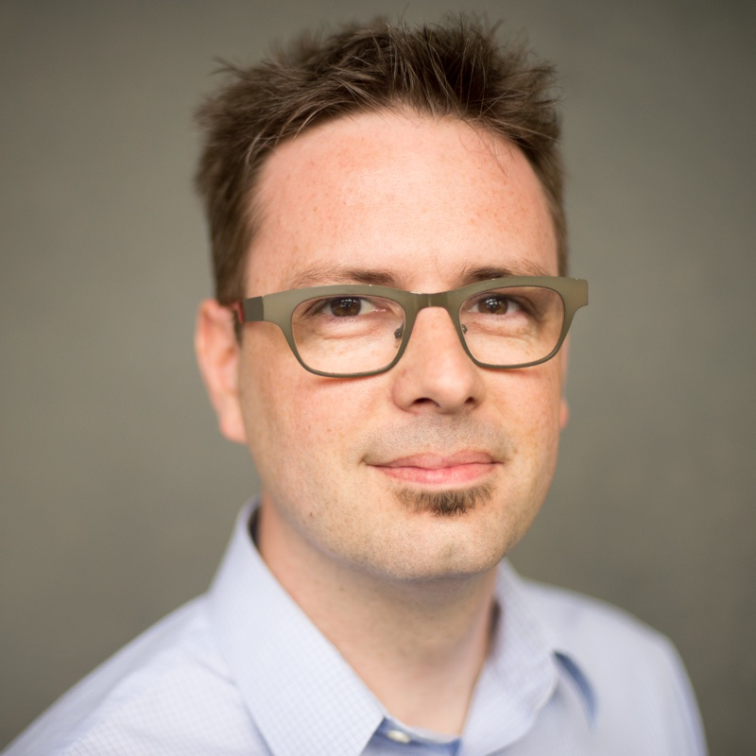
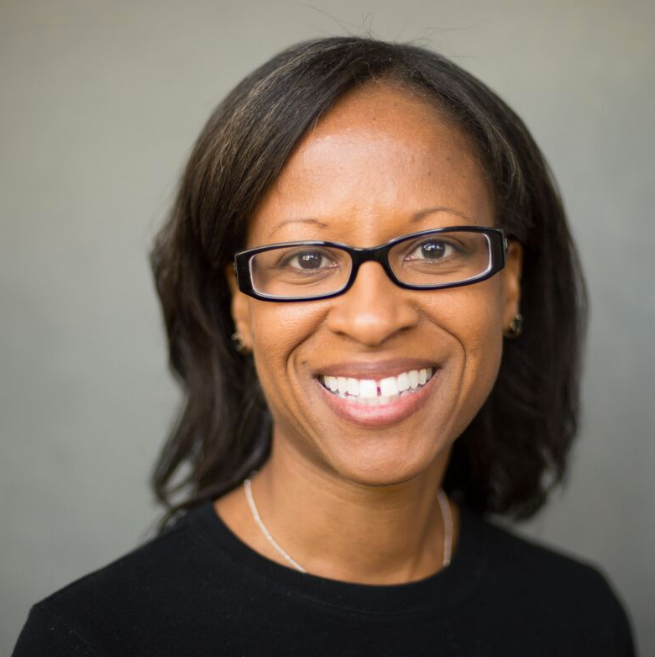
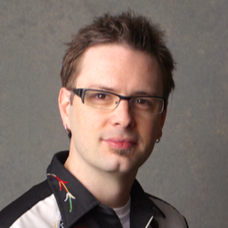
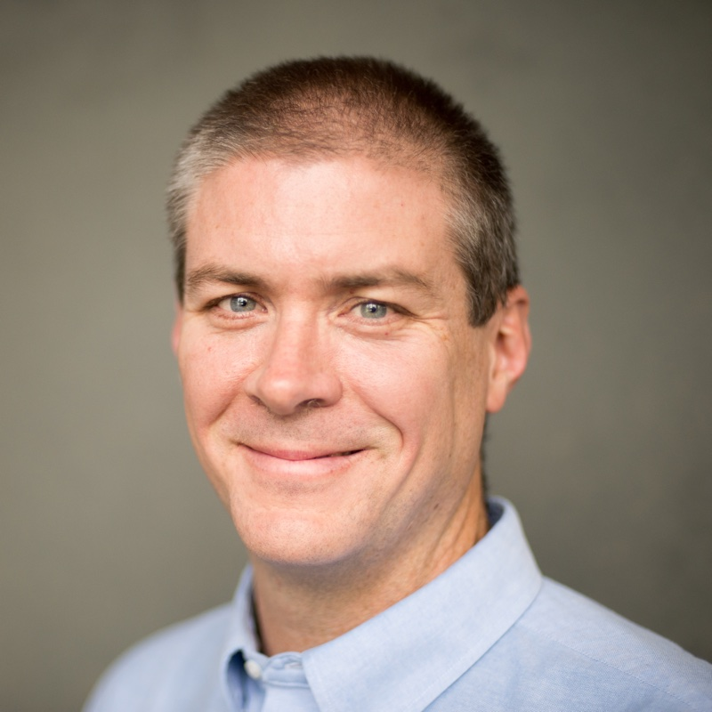

Who Are We
gina@mutuallyhuman.com
@ginawinkler
samuel@mutuallyhuman.com
@shmuel
mike@mutuallyhuman.com
@mikedoel
Notes:
[GINA] INTROS
Gina Winkler, Managing Director
Mike Doel, VP Engineering
Also known as Principals
Both previously worked for AOL/Netscape, launched startups, succeeded, failed, etc.

Slide 4
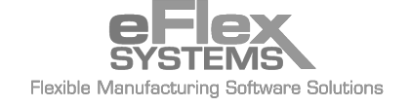




About Mutually Human
what
We Craft Humane Software
why
We love what we do because we get to make your job easier, or your free time more fun, or maybe your hospital visit safer. Whatever we're working on, we help get technology out of the way so you can worry about more important things.
how
When we apply our technical expertise, our ever improving process, and most of all our humanity to each product and service we design we're not just building better technology, we're making sure technology gets out of the way.
Notes:
[DOEL] WHAT IS NEO
Neo is a product innovation studio that combines lean processes with strategy, design and technology.
Ability to take a product from conception to production launch
Build the right thing in the first place
We have the pleasure of working with Jeff Gothelf, Josh Seiden, Giff Constable and the wonderful Jim Weirich.
Disclaimer: we stole Jeff’s slides

Slide 5
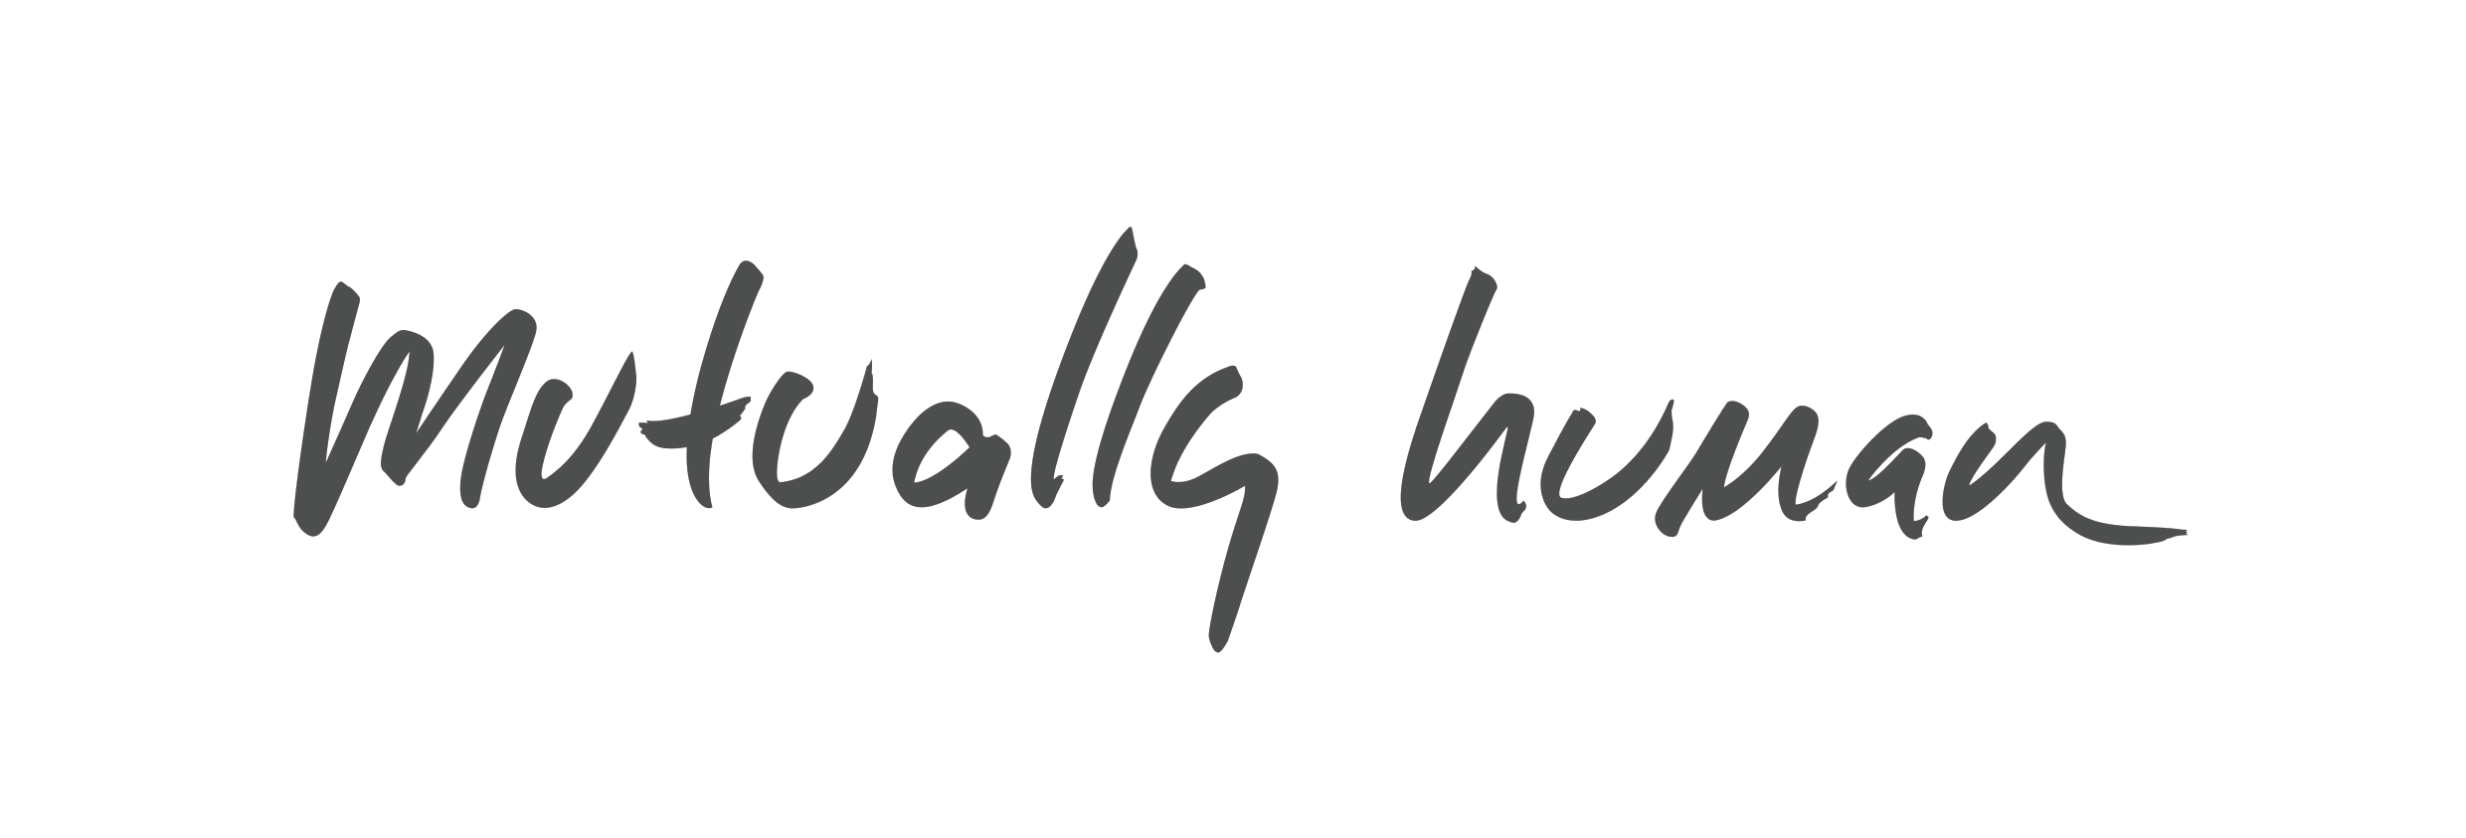

Slide 6
EXPENSIVE
Notes:
incredibly expensive software

Slide 7
ERP
Notes:
multi-million dollar ERP integrations

Slide 8
HOTEL MANAGEMENT
Notes:
a hotel management system

Slide 9
Notes:
retail management software for the
largest company in the world

Slide 10
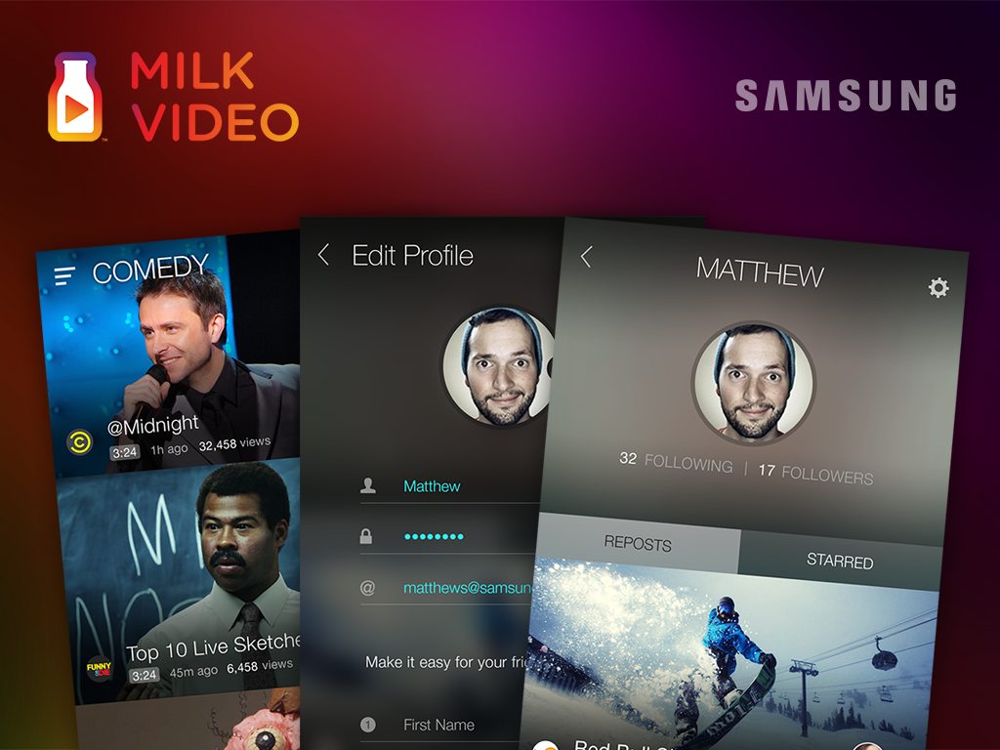
Notes:
a flagship video application for a name-brand phone vendor

Slide 11
1.2
Notes:
As I was preparing this talk I decided to go back over the estimated cost of all the projects I've worked on since I began designing software twenty years ago.
Over the past twenty years I've worked on an estimated

Slide 12
1.2
BILLION
Notes:
1.2 billion dollars worth of software.

Slide 13
The most expensive software in the world
Notes:
hich of these projects was the most expensive of all? In fact I'll step out on a limb and say no one in this room has worked on a project more expensive than this one.

Slide 14
The most expensive software in the world
is software that will
never be used.
Notes:
And unfortunately, I've worked on more than one
project that has ended up canceled before it was ever used,
or released to overwhelming disinterest.

Slide 15
DESIREABLE
USABLE
USEFUL

Slide 16
DESIREABLE
USABLE
USEFUL
VALUABLE

Slide 17
DESIREABLE
USABLE
USEFUL
VIABLE
PROFITABLE
Notes:
People have to desire your product before they'll try it,
useable before it can become useful,
degree to which it is useful will determine it's value.
Build something valuable and it will be much easier to turn that value into profit.
Skip at your peril. We know because we've been there.

Slide 18
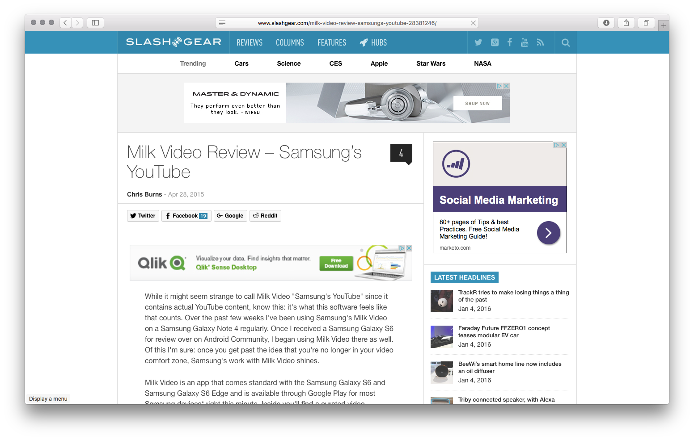
“Samsung's YouTube”
“a curated experience like no other”
Notes:
Slashgear

Slide 19
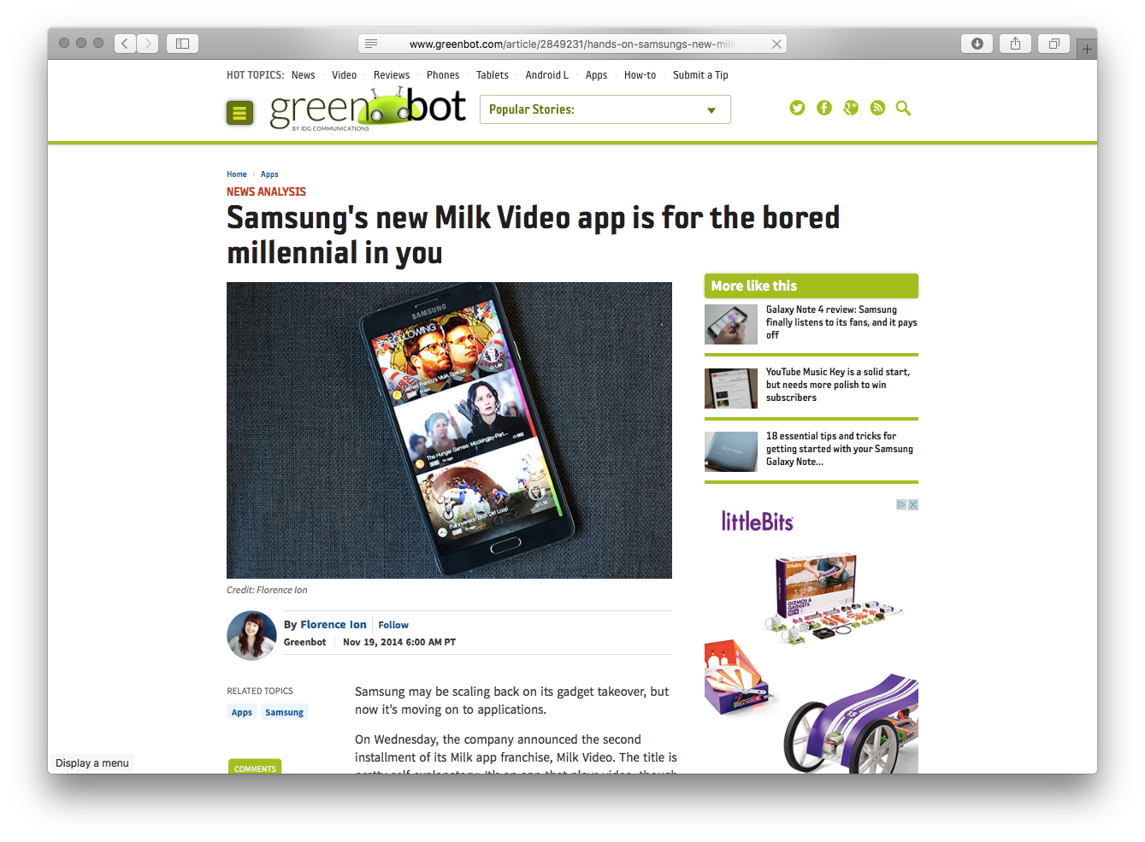
“It’s ridiculously easy to use.”

Slide 20
Notes:
video aggregation app presented videos from

Slide 21
1 YEAR +
1 DAY

Slide 22
Well Built
Robust Features
Strong Marketing
Critically Acclaimed Design
Easy to Use
Notes:
can't get much better placement than coming preinstalled on every new Samsung phone

Slide 23
“as slick as Samsung's new app is, I just can't help feeling that I'd be more excited about Milk Video if it were more than just another YouTube or Vimeo alternative.”

Slide 24
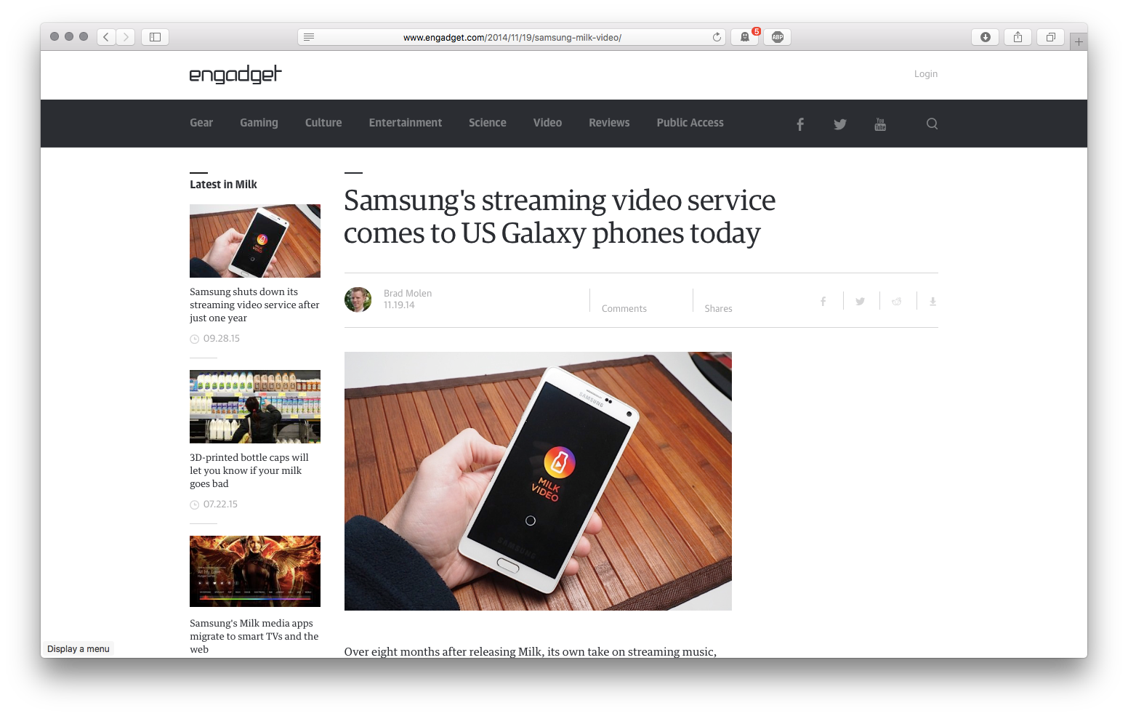
“Do we really need another streaming video option, or will Milk Video just get lost in the mix?”

Slide 25
CRAFTSMANSHIP
Notes:
stable, scalable, and well tested.

Slide 26
What's worse than a shoddy product?

Slide 27
A product no-one ever wanted to begin with.

Slide 28
FEATURE FEATURE FEATURE
+
PRODUCT

Slide 29
COST / VALUE
Notes:
ROI

Slide 30
PRODUCT DEBT
Notes:
The accumulation of low value features:
Features add complexity & cost to maintain
Cost becomes infinite when multiplied by the long term impact of low-value features

Slide 31
PRODUCTS PEOPLE LOVE TO USE

Slide 32
READY?

Slide 33
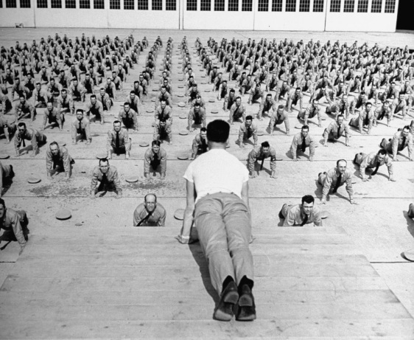

Slide 34
DESCRIBE YOURSELF
Notes:
Design or Product
Engineering
Project Management
Business

Slide 35
GREEN
BROWN
Notes:
Green field projects
Brown field projects

Slide 36
AGILE
WATERFALL
Notes:
Waterfall
Thinks they do Agile
Actually do Agile
Hate Agile and wish people would shut up about it

Slide 37
Primarily
>
LEAN IS FOR:
Notes:
Startups
The Enterprise
Car Companies
Software Hipsters

Slide 38
What We’re Solving
Conference Meetup
- Those who get the most out of conferences often say it’s because of the social elements.
- Could we help more people feel this way by creating a product/service that encouraged attendees to meet other people at the conference?
Notes:
[DOEL]
Explain idea
Thoughts from room?

Slide 39
Assumptions & Hypothesis

Slide 40
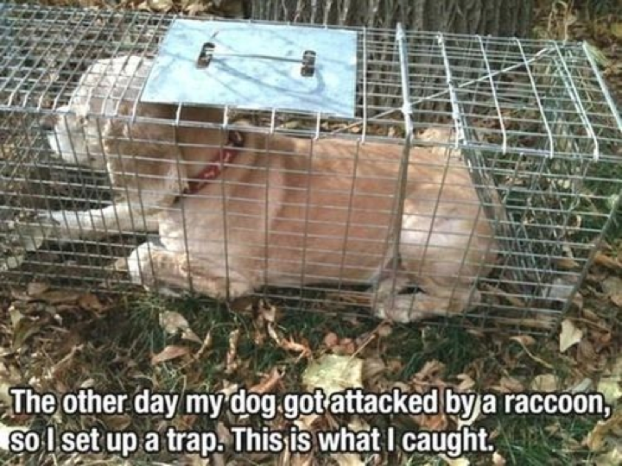
Notes:
This gentleman’s dog got bitten by a raccoon. So he built a trap and this is what he caught.
the point here is, we will not know if our product will get used, if it will solve a real problem or even be used the right way until we put something in the customer’s hands
the key is, what we put in their hands doesn’t have to be complete.
Valuable learning can be obtained with very little effort, and no lines of code..
When this happens, bc it’s already out there…
we get caught creating feature after feature to “fix” it or make it better.
the goal is to learn how to choose the features that make the most sense, and keep the product laser focused on what the user actually needs.

Slide 41
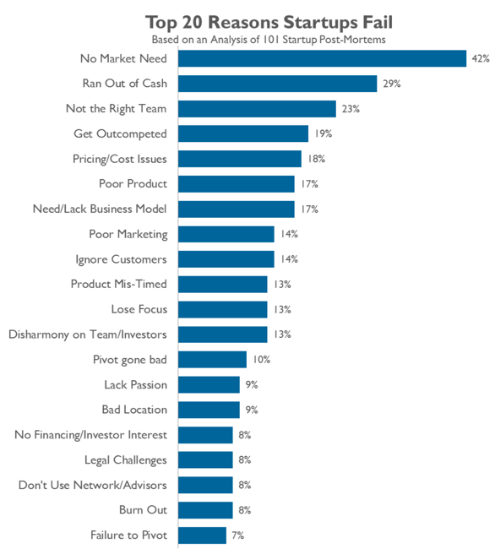
Why Startups Fail
https://www.cbinsights.com/research-reports/The-20-Reasons-Startups-Fail.pdf
Notes:
As illustrated by CBInsights poll last year of 101 startups that failed, nearly half of the companies that fail find that
after taking many months and lots of someone else’s $ to build something, there is not market need.
Or, they built it, put it out there, iterated to the need, but ran out of cash, thus time.
die 20 months after raising financing about $1.3 million
Principles we’ll run through today center around providing ways to help
. move from doubt to certainty
. in less time,
. with a product that’s closer to right
before spending $$ to build it fully.
(Fail faster)

Slide 42

Notes:
Here’s a case where things went well.
ShareThis’s original idea was to serve as a platform to track things people shared, and then present it back to them.
The assumption was that if I share a bunch of cat videos, and someone else shares a bunch of things about cat videos and Ford Mustangs, then the likelihood that I ALSO might like mustangs is high.
User = sharers on Facebook/MySpace
Solution = give them something to spy on them
interviews
assumption was the sites were taking off bc users enjoyed posting stuff

Slide 43
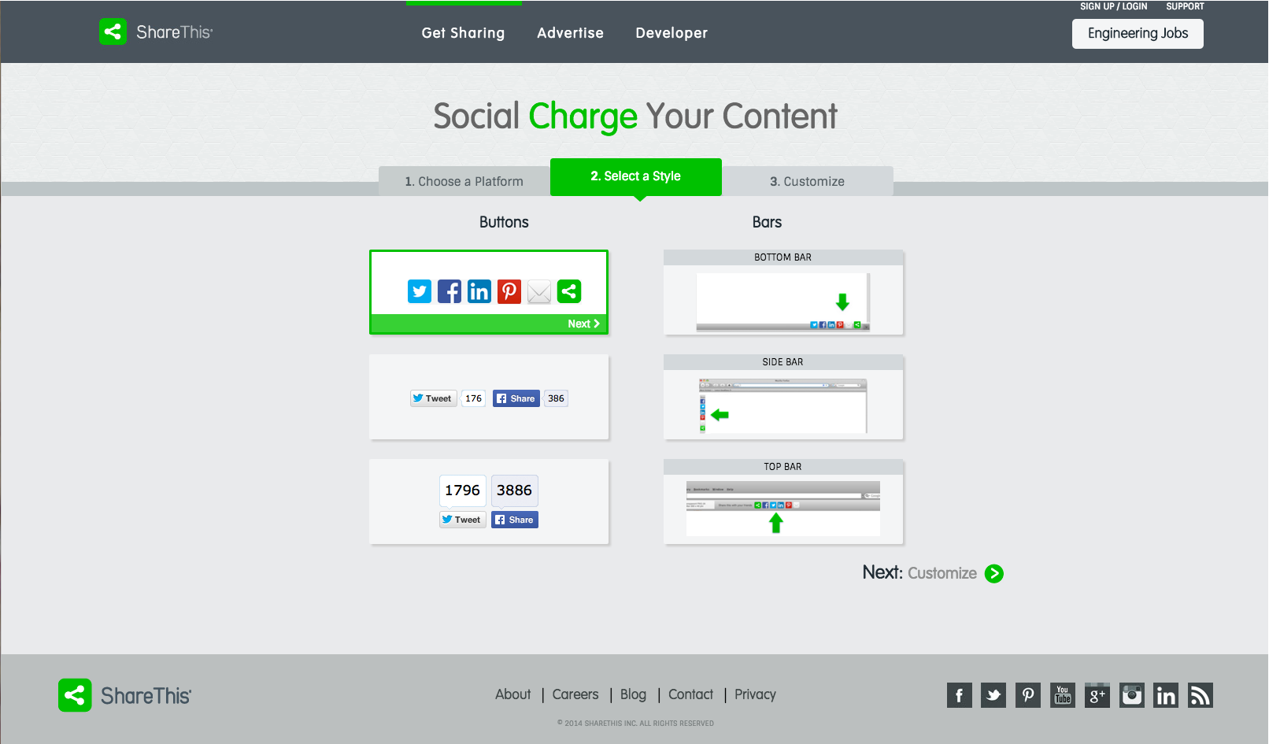
Notes:
Interviewed 300 users over 2 months - assumptions were wrong
usage was in messaging, not sharing → they didn’t care about profile pages, only communicating
user = publisher
solution = easy to grab and install share button that omits all the buttons at the bottom of the page.
Key: learned in time to pivot

Slide 44

Software is continuous
Photo by Tom Woodward
https://www.flickr.com/photos/bionicteaching/2131859871/
Notes:
The fundamental shift is that the nature of software has changed.
We’re not making lots of copies of a known thing
We’re making 1 continuously evolving thing
Because of this continuous process, we’re building a continuous feedback loop
- an opportunity to hold a conversation with our user, our market.
We can launch it, measure and assess if it’s working...and then react to the change as quickly as we can push software out.
Each conversation provides learning about how our market interacts with the product.
Continuous learning (build, measure, learn)
This allows us to determine, faster than 5 months later, if we’re building something that people actually
1) like, and 2) want to use 3) find value in, and 3) if it makes sense to further invest in scaling it.
This is the key as it has changed our ability to determine what to build.
In between doubt and certainty is a lot of fog. Can only see clearly 2-3 steps ahead
Lean is a set of tools & practices that are used during the process of moving from doubt to certainty

Slide 45
Moving from Doubt to Certainty
This is going to be BIG!
No one clicked.
Make a design decision
months
Get feedback from market
hours
Concept credit: @clevergirl
Notes:
The Goal: FAIL FASTER
Decrease time from idea (doubt) to reality (certainty) from 5 months to 5 hours, 1 year to 5 days
Mitigate risk of running in the wrong direction
by taking small steps/small risks/experiments into the fog
If results confirm your thinking, then continue. If not, step back, change direction and try again
Today’s workshop will hopefully provide a few tips and tricks to not only building it right, but building the right thing in the first place.
Less risk, more often.

Slide 46
11.6
Notes:
This is how often Amazon pushes to production.
They are not redesigning the checkout process or product page 5 times/minute
Tiny bites of risk to small groups of users
They push it, observe, measure and learn.
They open a conversation with a user somewhere in the world, 5 times/minute
If it moves the proper needles in the right direction, then they make an investment and scale it.
If not, they accept their reality & roll it back
The scope of the failure is small. work in small batches. But the learning is huge
Taking steps from doubt to certainty.

Slide 47
A quick thing about teams
A “team” typically includes at least one of each discipline (product, design, 2-3 dev...a 2-pizza team)
everyone is creative and has secondary competencies.
Notes:
slide: shared understanding thread followed by Rachel’s messy room
So participate! Everyone has something to add, and the more diverse the input, the closer to reality (quicker time through the fog) you’ll be.

Slide 48
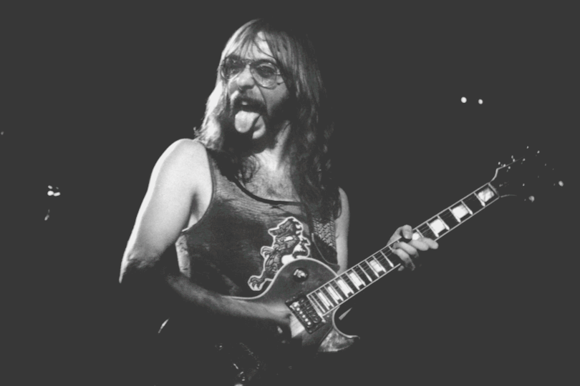
Jeffrey Allen "Jeff Skunk" Baxter (born December 13, 1948) is an American guitarist, known for his stints in the rock bands Steely Dan and The Doobie Brothers during the 1970s. More recently, he has been working as a defense consultant and chairs a Congressional Advisory Board on missile defense.

Slide 49
A quick thing about teams
A “team” typically includes at least one of each discipline (product, design, 2-3 dev...a 2-pizza team)
everyone is creative and has secondary competencies.
shared understanding is key to moving fast

Slide 50
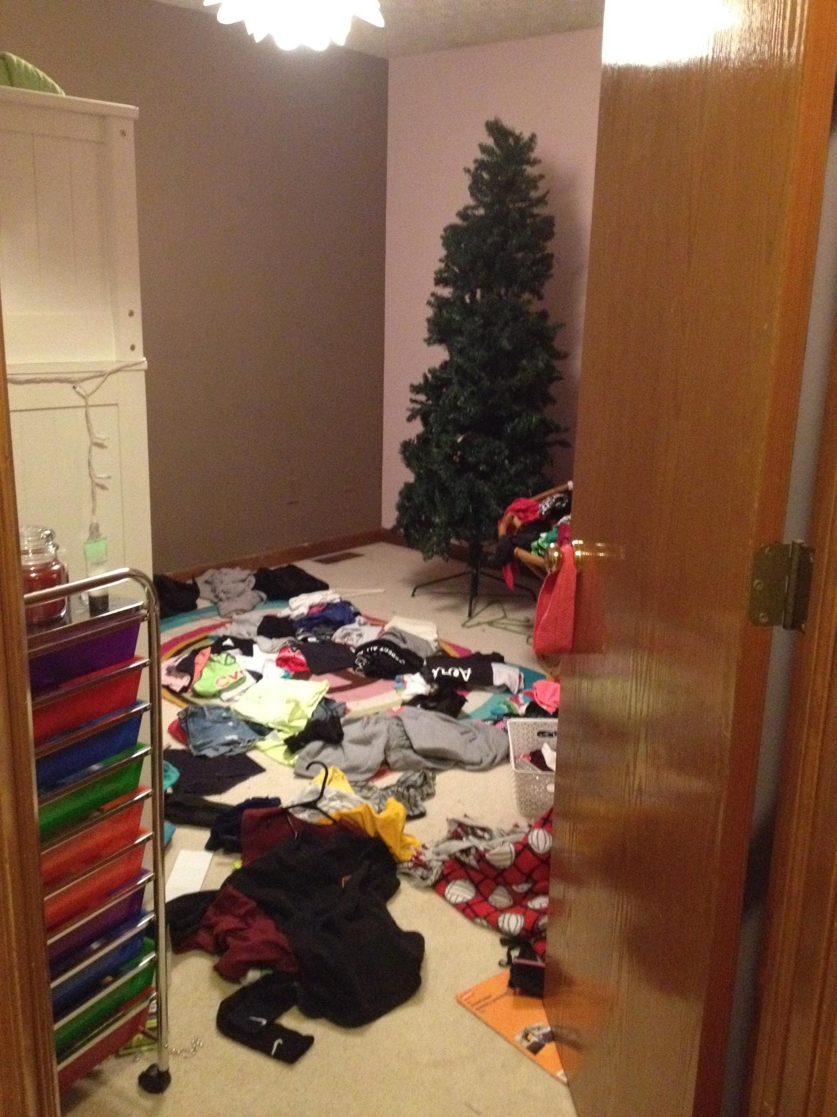
Notes:
Daughter’s room.

Slide 51
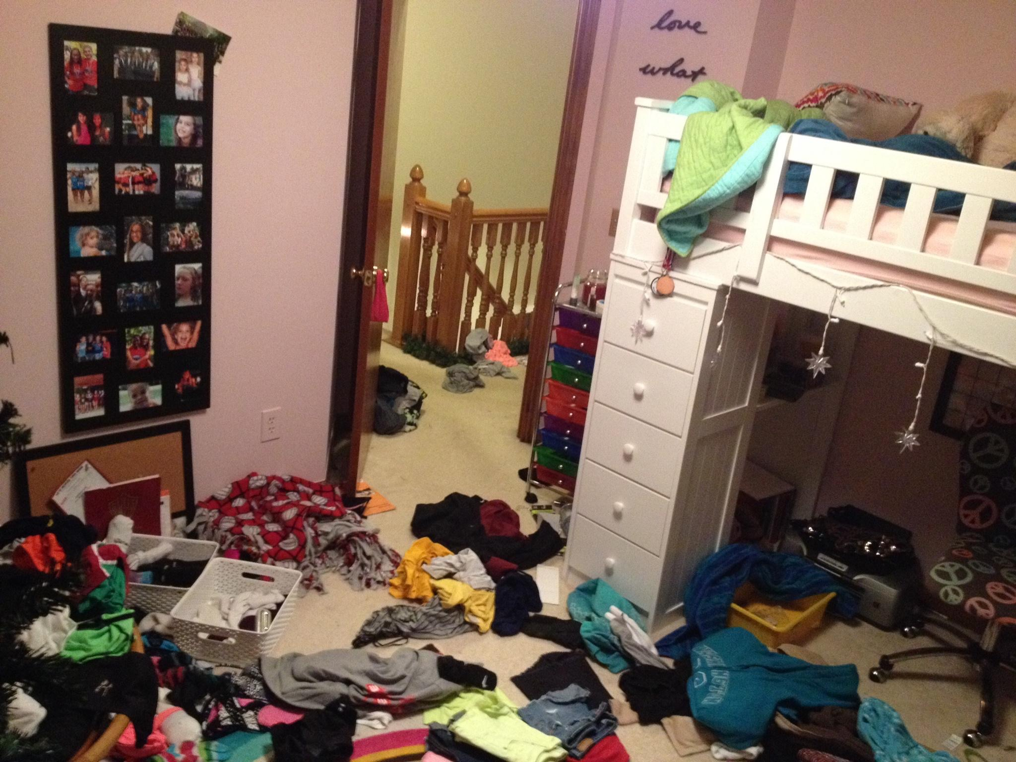
Notes:
If you were to visit my home, this is what you’d see
Visit my home, pass by room —> “typical teenager”
maybe pass judgement that she’s a slob
Live with us —> you’d know
honor roll, 3.8
travel vball
6 days/week sports and school

Slide 52
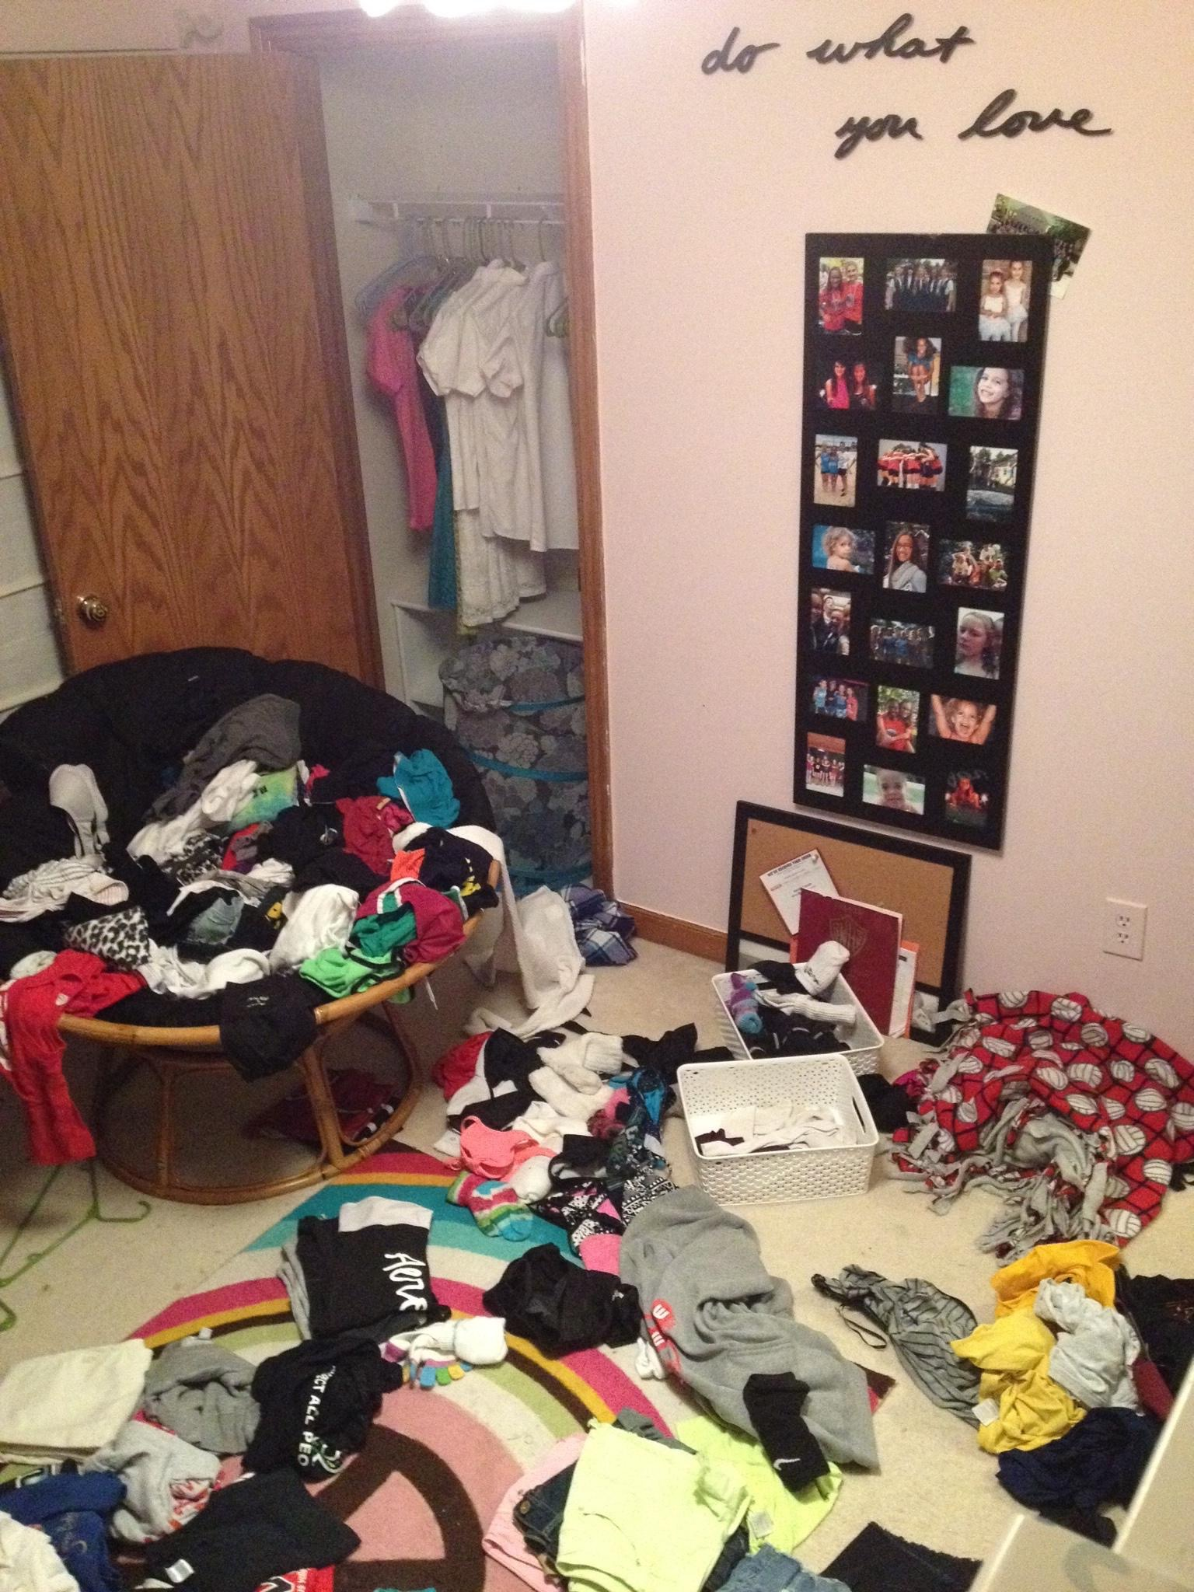
Notes:
But if you were to live as her roommate for a few months —>
I removed the dresser
replaced with shelf that’s too shallow to hold anything
sisters enter room each morning, dump the dirty laundry and pull each other around in the basket
Lots of view points on the same room.
the more diverse the input,
the closer to reality (quicker time through the fog) you’ll be
- but everyone has to be on the same page.

Slide 53
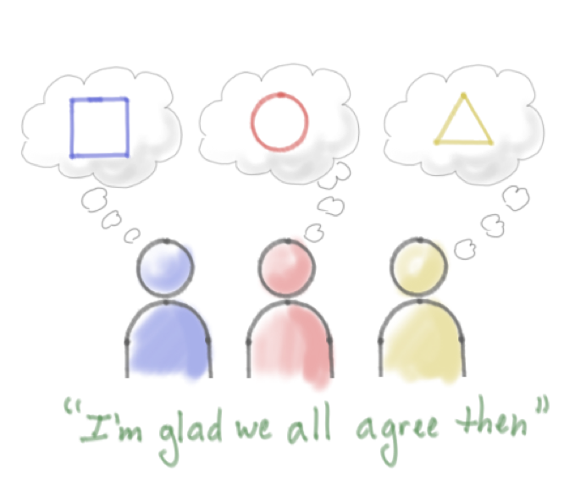
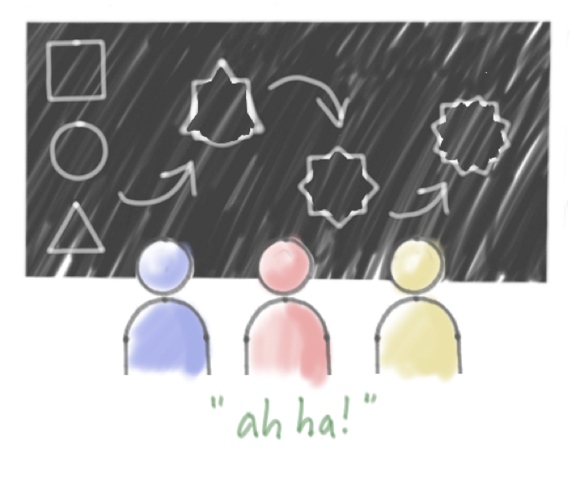
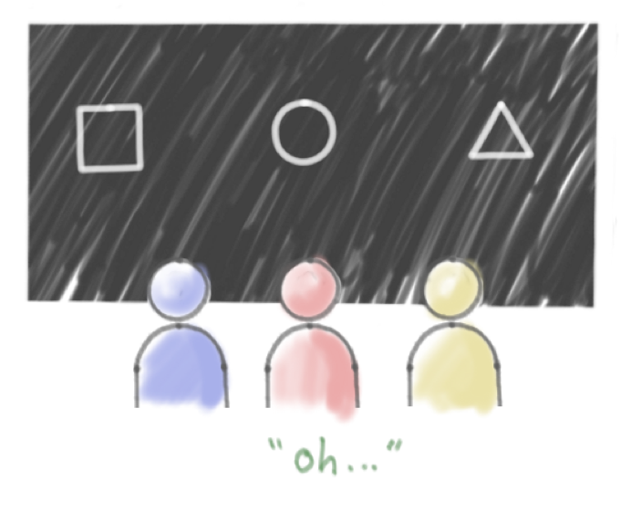
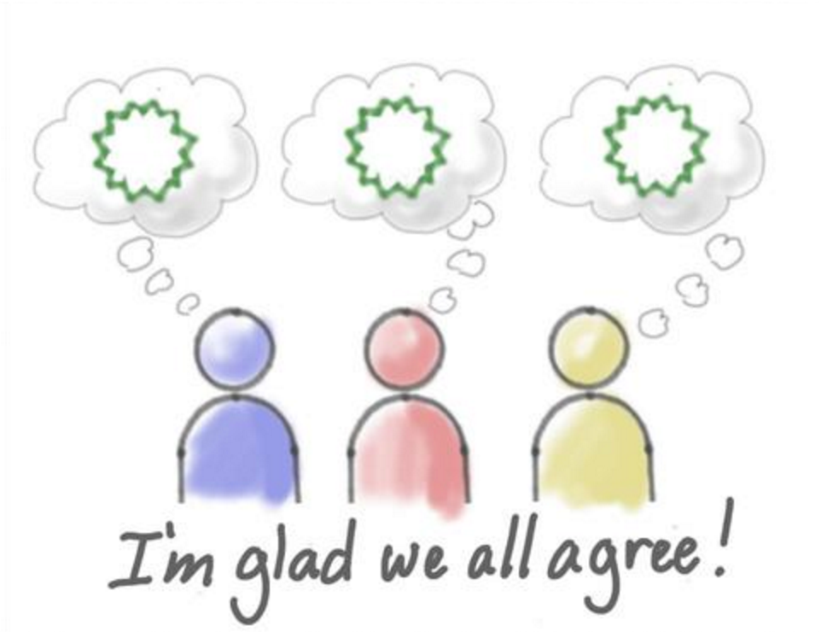
Building Shared Understanding
http://www.agileproductdesign.com (Jeff Patton)
Notes:
Visualizing ideas reveals inconsistencies
Regular discussion and iteration leads to
shared understanding

Slide 54
Let’s do this!

Slide 55
Declare your assumptions
What assumptions do you have?
…about your customers?
…that if proven false, will cause you to fail?
In other words:
what do you need to know in order to move forward successfully?

Slide 56
360 Degree Assumptions
Customer/User
Problem
Solution
Customer
Outcome
Customer
Acquisition
Early
Adopter
Business
Model
Key
Competitive
Advantage
Competition
Notes:
Who is the user? Where does our product fit in their work or life?
What problems do they have?
How should our product look and behave?
What features are important?
When and how is our product used?
How will we acquire customers?
How will we make money?
Who are our competitors?
What’s our differentiator?
*What’s our biggest risk?*

Slide 57
ShareThis
Our target customer will be college students age 18-24 who are active on social networks such as Facebook and MySpace
The problem our customer wants to solve is being able to share files amongst each other without using email.
The solution we will provide is a service to allow file transfer regardless of origination or destination service.
The measurable outcome our customer wants to achieve is using one service to send files or attachments, thus less file sharing via AOL Instant Messenger (AIM)
Our primary customer acquisition tactic will be Facebook promotion
Our earliest adopter will be Facebook users
We will make money (revenue) by making share data available to advertisers/publishers
Our primary competition will be AIM
We will beat our competitors primarily because of POS being directly via Facebook usage.

Slide 58
Exercise - Declare Assumptions
Grab an assumptions template worksheet
Define your assumptions
- use post-its on the wall if needed!
15 minutes

Slide 59
Assumption Ranking
High
Impact
Low
High
Low
Confidence

Slide 60
Assumption Ranking
High
Danger
Zone
Impact
Low
High
Low
Confidence

Slide 61
Exercise - Ranking Assumptions
Identify the three riskiest assumptions to the business/product.
15 minutes

Slide 62
Exercise - Feature Definition
Pick one of your top three assumptions.
What features will solve the users’ problem?
Dump and sort on the wall.
10 minutes

Slide 63
...turn assumptions into Hypotheses
[building this feature]
We believe that
[for these people]
will achieve [this outcome].
We will know we are successful when we see
[this market feedback].

Slide 64
Exercise - Hypothesis Statement
Take a look at your wall:
feature ideas
top riskiest assumptions
users
Organize your thoughts to create a hypothesis.
5 minutes
Group Read-Out
- what’s your idea?
- what’s your hypothesis?

Slide 65
Break!
Start again in 10

Slide 66
Customer Development

Slide 67
2009
Notes:
Before we talk about Customer Development, let’s go back in time just a bit to 2009.
Avatar was the top grossing movie of the year
Susan Boyle, from Britan’s Got Talent, became a youtube sensation and released the top selling album of the year
Barack Obama became president
Everyone was playing World of Warcraft

Slide 68
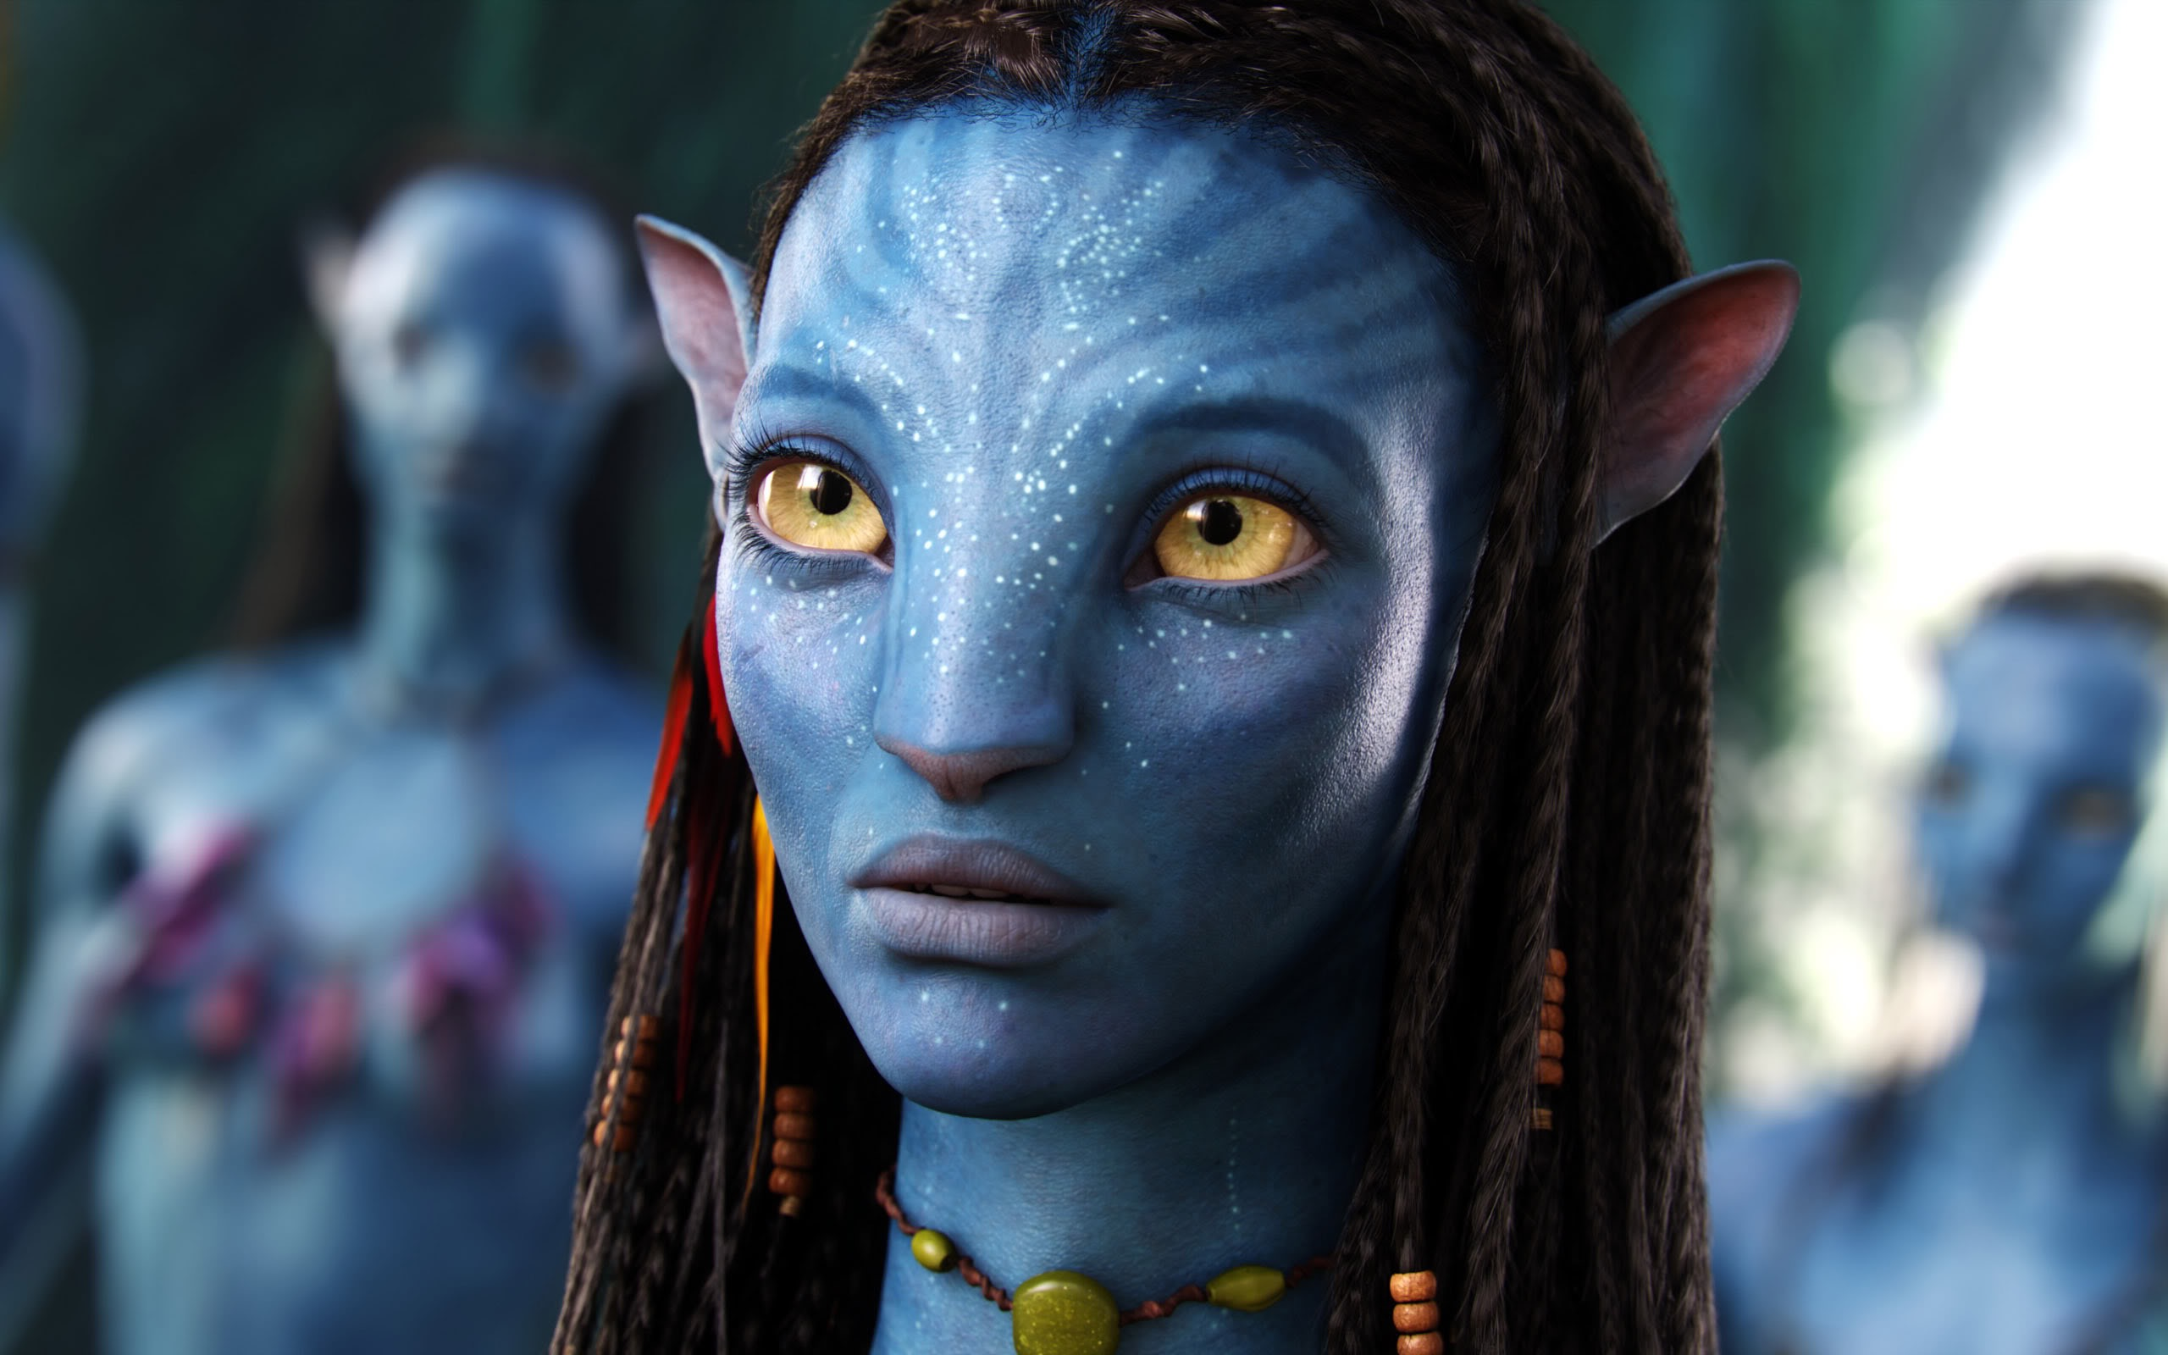

Slide 69
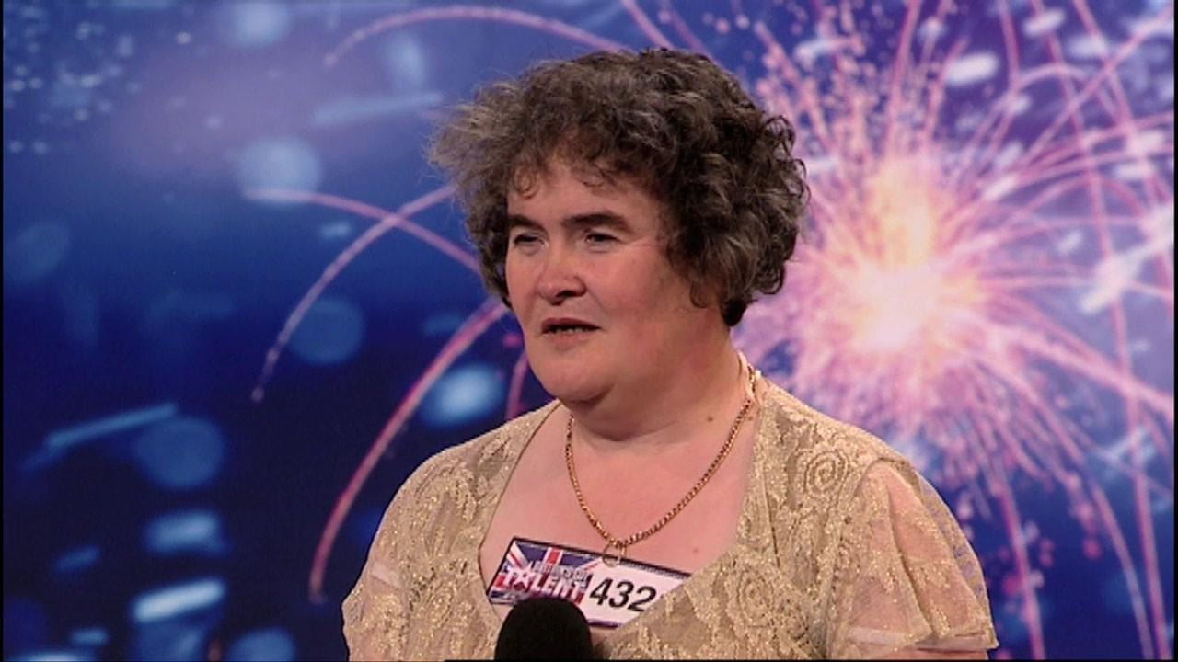

Slide 70


Slide 71
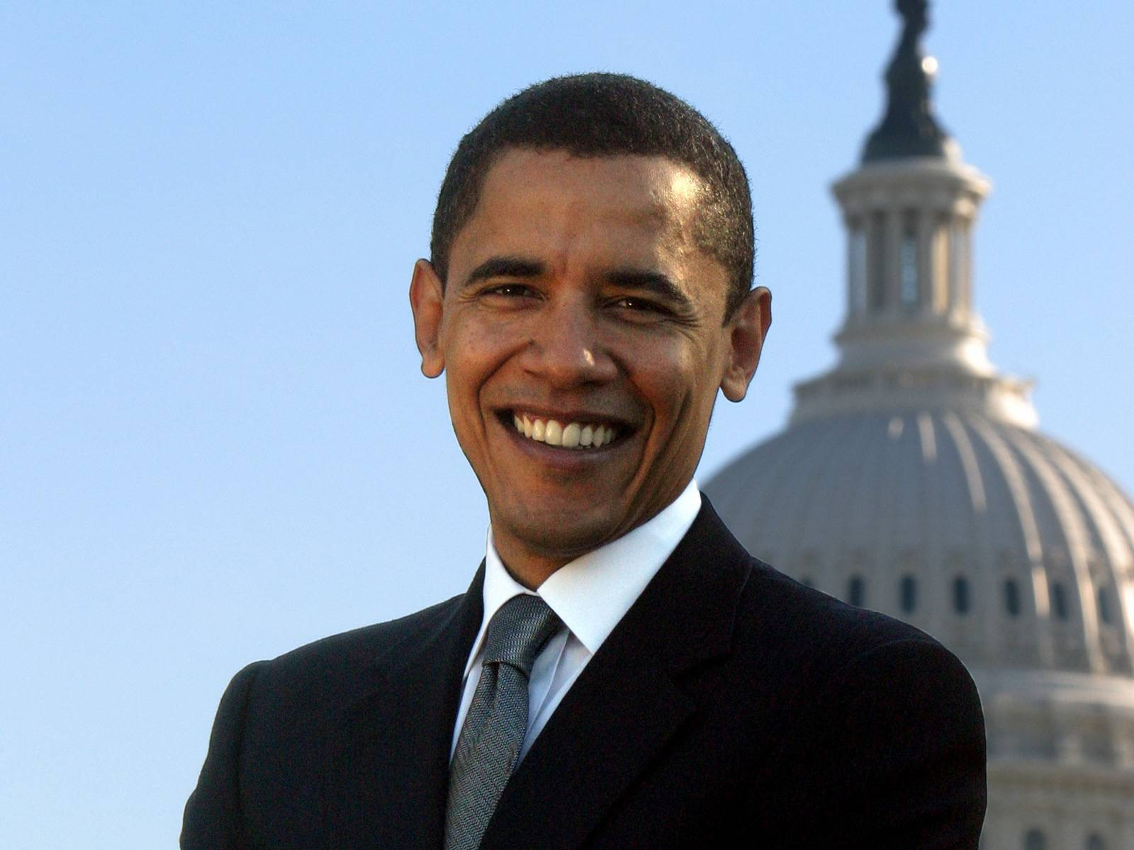

Slide 72


Slide 73
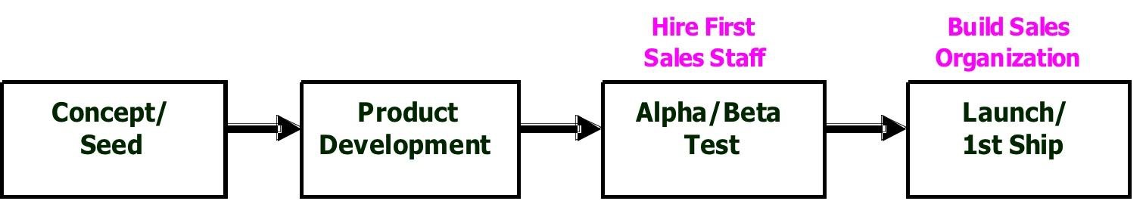
Product Development Model
Notes:
And this is how you created and build a startup company. You began with an idea, raised money to fund product development, did some initial alpha and beta testing, and launched a product that was consistent with the founder’s vision.
Assumes a “build in and they will come” mentality
Sales and marketing costs are front loaded
1st customer ship becomes the goal
Tremendous opportunity for waste

Slide 74
TIMESHARES

Slide 75
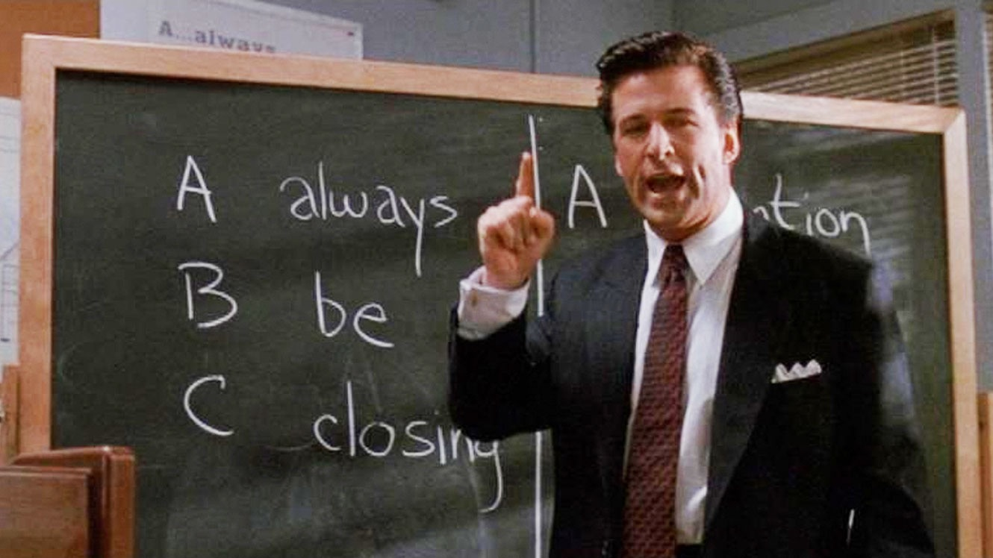
Timeshares
Notes:
What image comes to mind when I mention timeshares? Many people associate the word with the worse excesses of the industry.

Slide 76

Timeshares
Notes:
But timeshares can also be a terrific and affordable place to stay on a vacation.

Slide 77
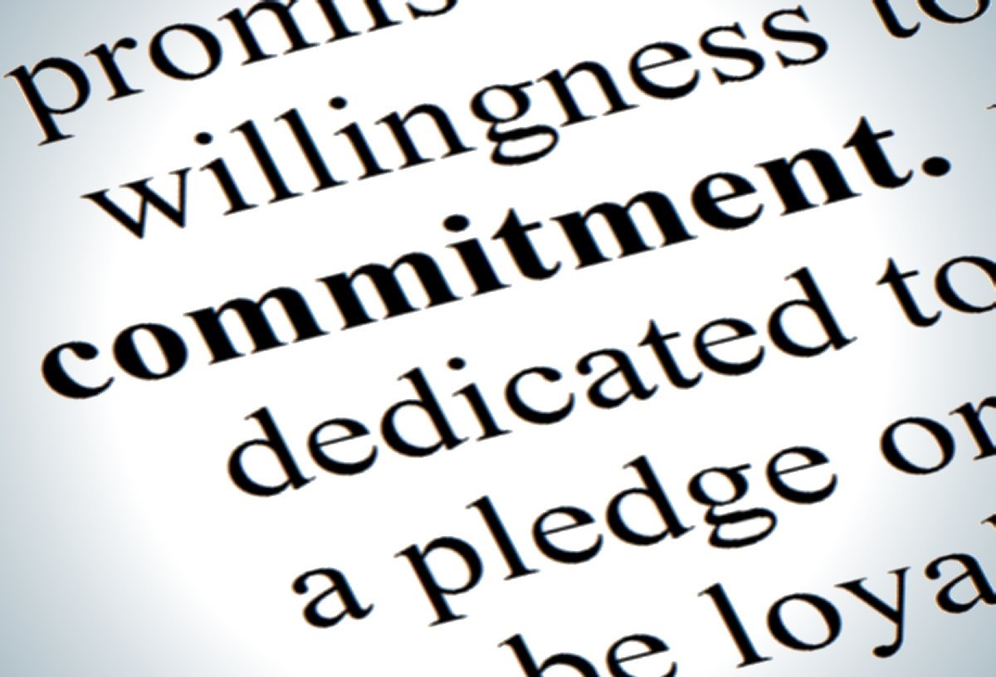
Notes:
The biggest problem with timeshares of course is the commitment. With more flexibility, timeshares can be a not horrible investment. The industry realized this long ago and companies like RCI and Interval International sprung up to facilitate timeshare exchanges among owners. The problem is that they were not very good.

Slide 78
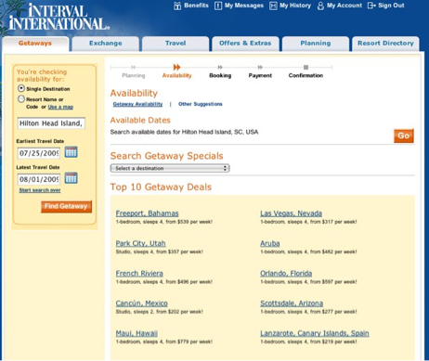
Notes:
Here’s an example of what one of these sites looked like at the time. Beyond being tedious to use, there was a real problem with them - getting fair exchanges proved difficult or impossible if you didn’t know how to play the game.

Slide 79
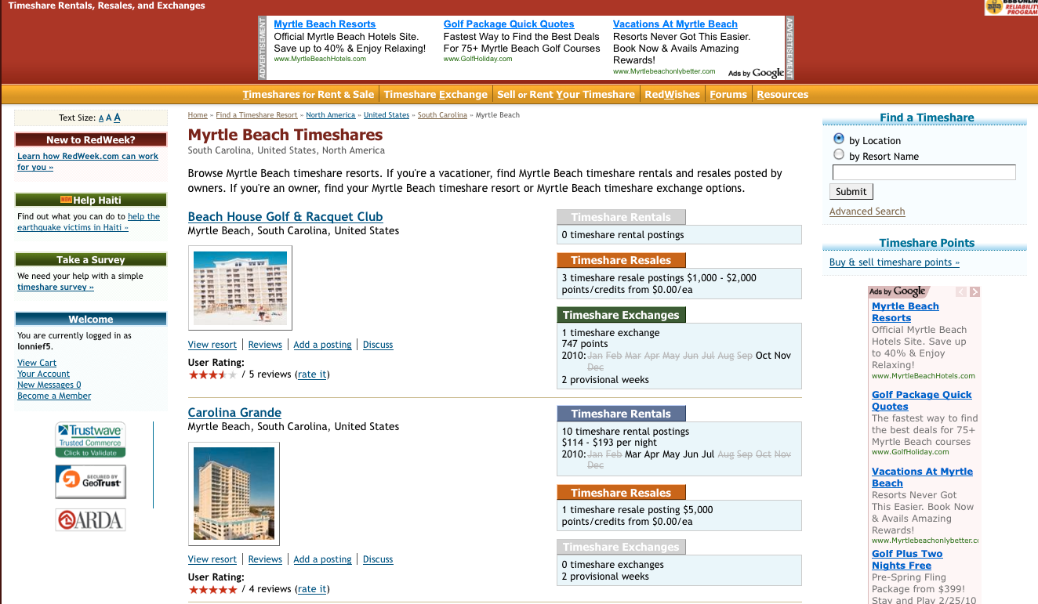
Notes:
Many of the available alternatives required you to pay a registration fee to belong and charged you a listing fee to even have an opportunity to find a trading or rental partner.

Slide 80
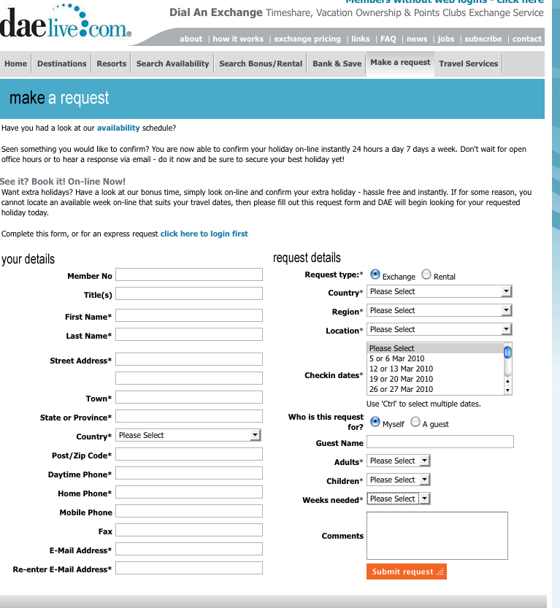
Notes:
And the user interfaces were pretty dreadful

Slide 81
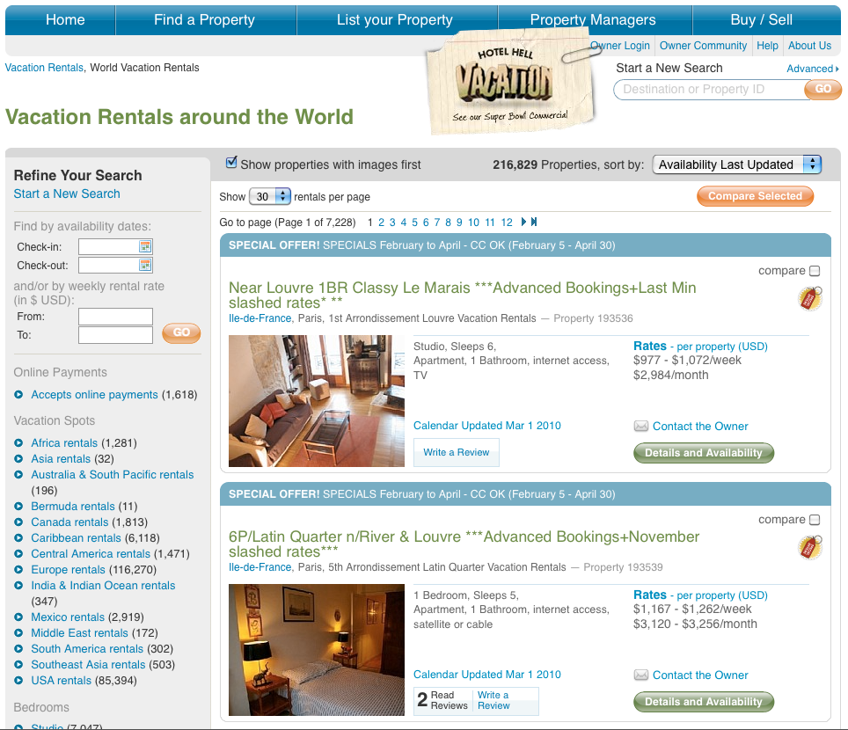
Notes:
Eventually, people started to see opportunity and created new options that were better. In 2009, AirBnB had just got off the ground and nobody had heard of them yet. At the time, you would have put your money instead on HomeAway as the best positioned company in the vacation rental market. They managed to raise approximately $500M between 2005 and 2008. Their user experience was far better than others, but still not great.

Slide 82
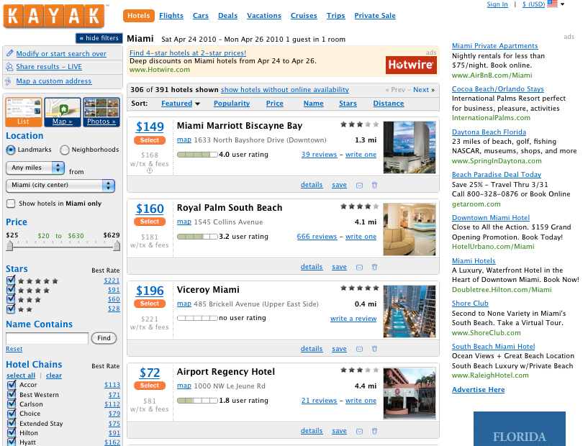
Notes:
While not in the time share industry, Kayak paved the way for using sophisticated filtering to narrow down on the choices that worked best for you. Kayak raised $225M between 2004 and 2007.

Slide 83
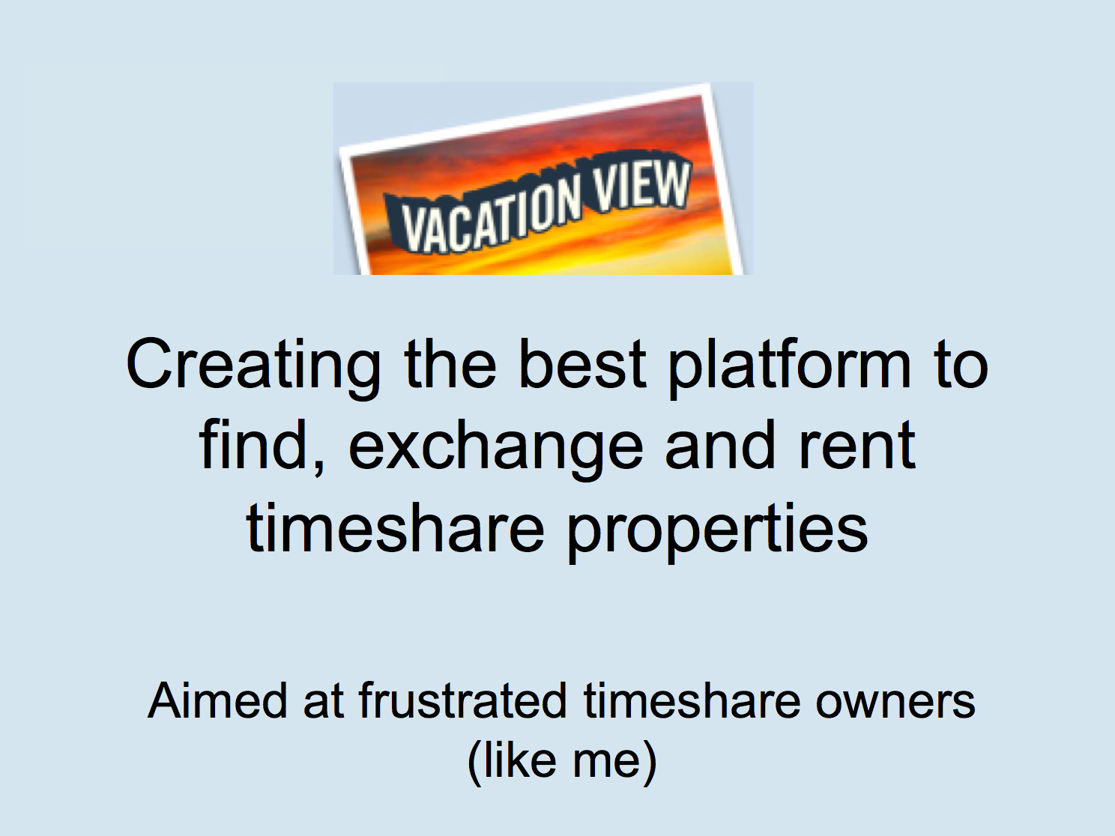
Notes:
One piece of advice you often here is to build a product for yourself and then see if others want it. A friend of mine happened to own two timeshares and had personal experience with the shortcomings I’ve mentioned. So, in 2009, he and I, joined by two others, put our World of Warcraft ambitions on hold and instead created a startup to see if we could build a better mousetrap and attract even a fraction of the interest that HomeAway and Kayak were getting. This is the opening slide of our pitch deck.
Our idea was to bring the user experience of Kayak to the timeshare industry with 4.7M owners in the US.

Slide 84
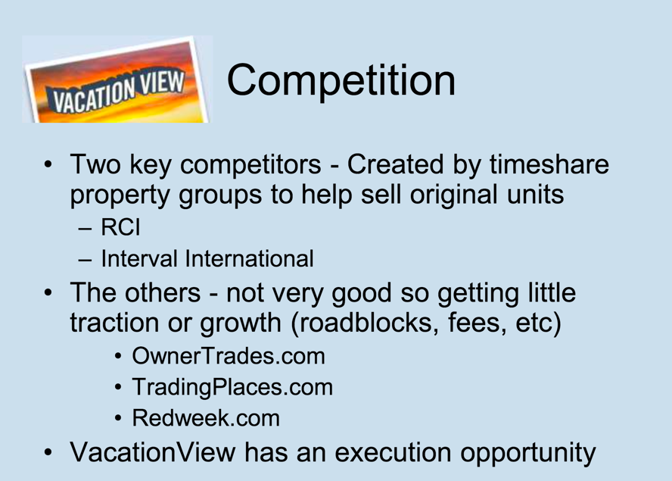
Notes:
We believed we had an execution opportunity.

Slide 85
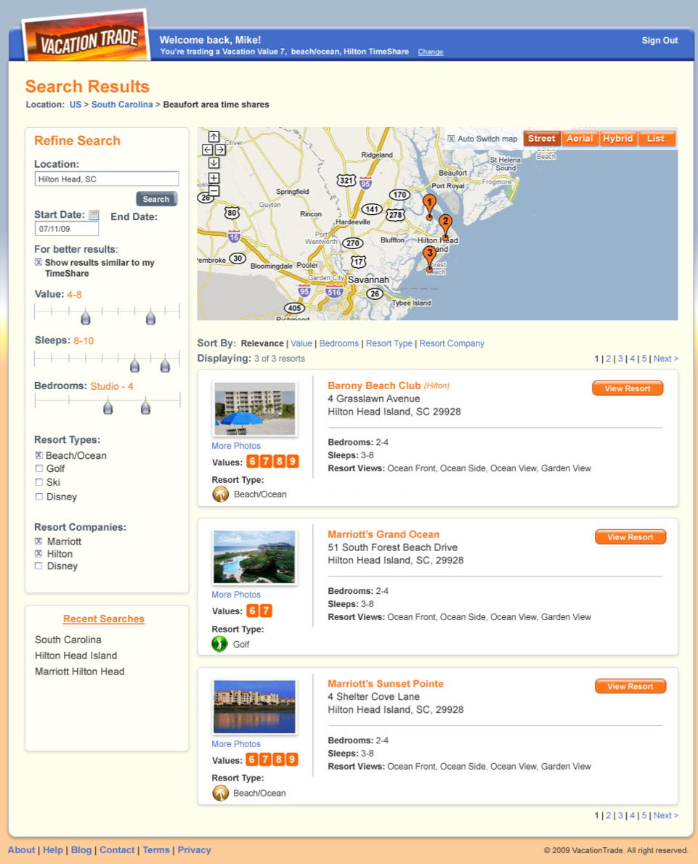
Notes:
We managed to get initial angel funding of $150K and used most of it to build a product that proved out the concept. Who were we proving it to? Unfortunately, we were using it to prove to investors that we could actually build a product and tell a compelling story.

Slide 86
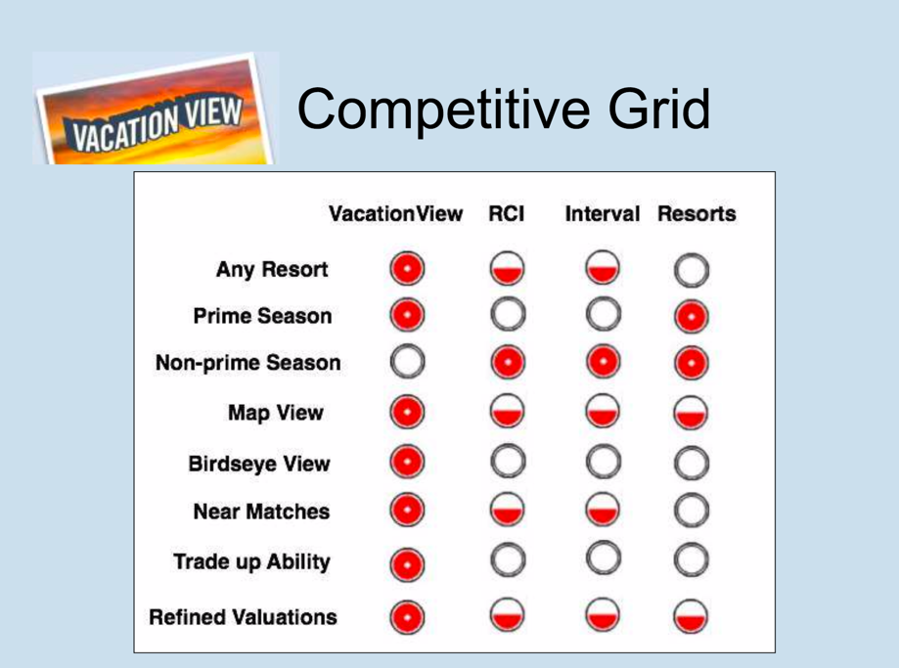
Notes:
We reassured ourselves that we would be successful because we would have features that other incumbents did not.

Slide 87
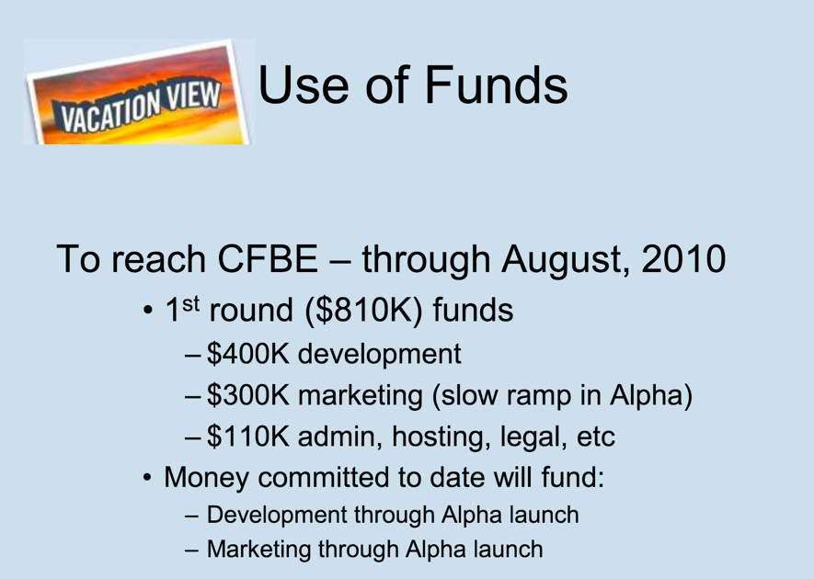
Notes:
We used this prototype to complete a fund raising round that netted us $810K by the end of 2009. Half of that money was to be used for software development with most of the rest going to marketing. We expected to launch in the spring of 2010 and be cash flow break even by August of that year.
When we launched the service we discovered an uncomfortable reality that seems obvious with the benefit of hindsight. Finding two owners to trade their timeshare weeks is difficult. Companies with the scale of RCI and Interval International could do it, but we didn’t have enough users to make trades happen.

Slide 88
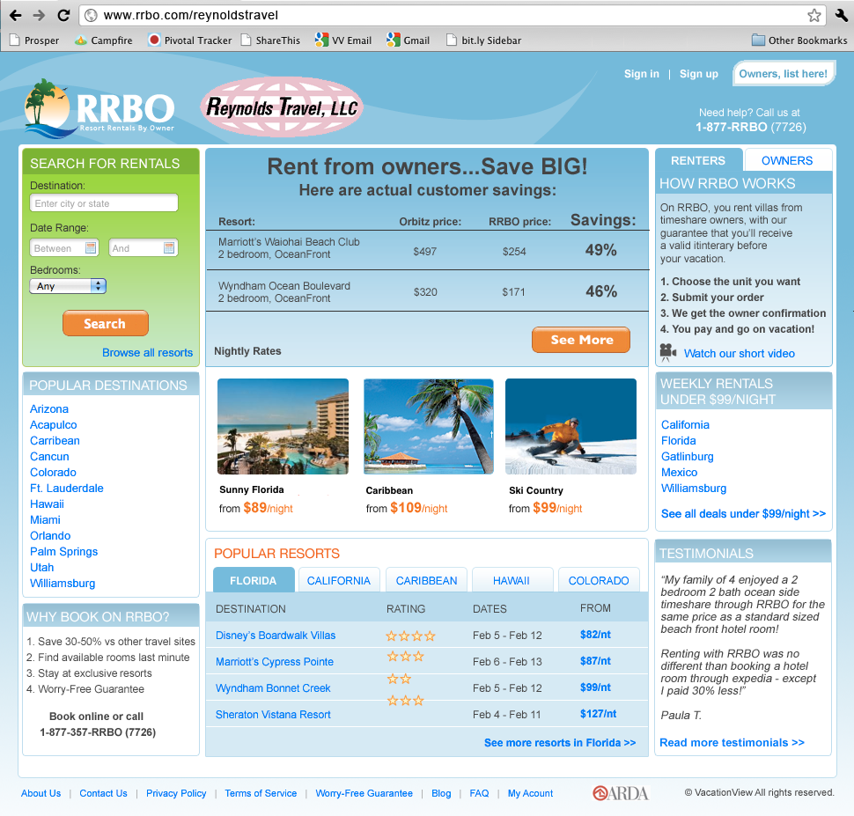
Notes:
And so we changed direction. If getting owners to swap weeks was hard, it should be easier to get an owner to swap a week for someone else’s cash - a rental. Using the same basic software, Resort Rentals By Owner went live in the late summer of 2010. To combat the problem of having not enough inventory, we decided we would scrape listings from a competitor’s site and mark up the price 15%.

Slide 89
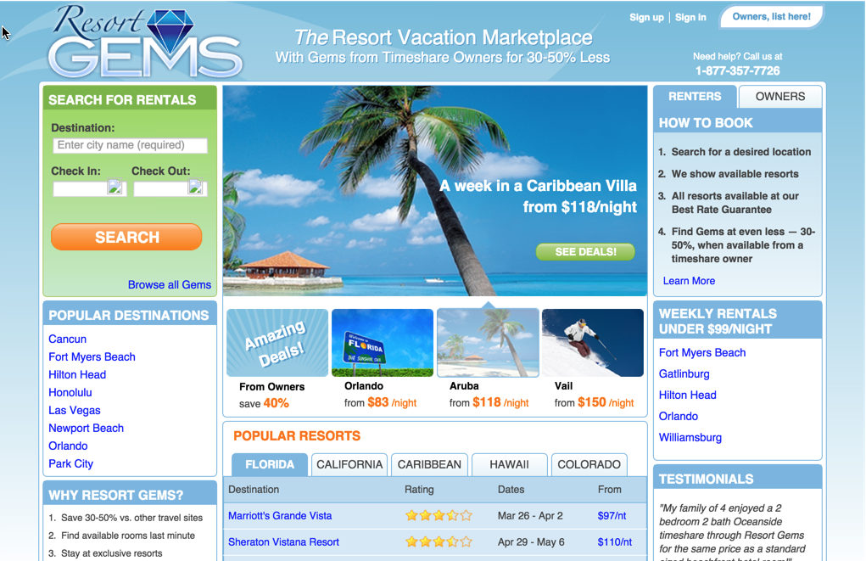
Notes:
While we found we could drive traffic to our site with Google search placements, our conversion rate wasn’t high enough to compensate for the ad spend. There weren’t enough listings and many that we scraped ultimately failed to pan out when a renter was found. We theorized that if we could get our customer acquisition cost down enough, we could reach positive cash flow. And so we rebranded in an attempt to be more recognizable.

Slide 90
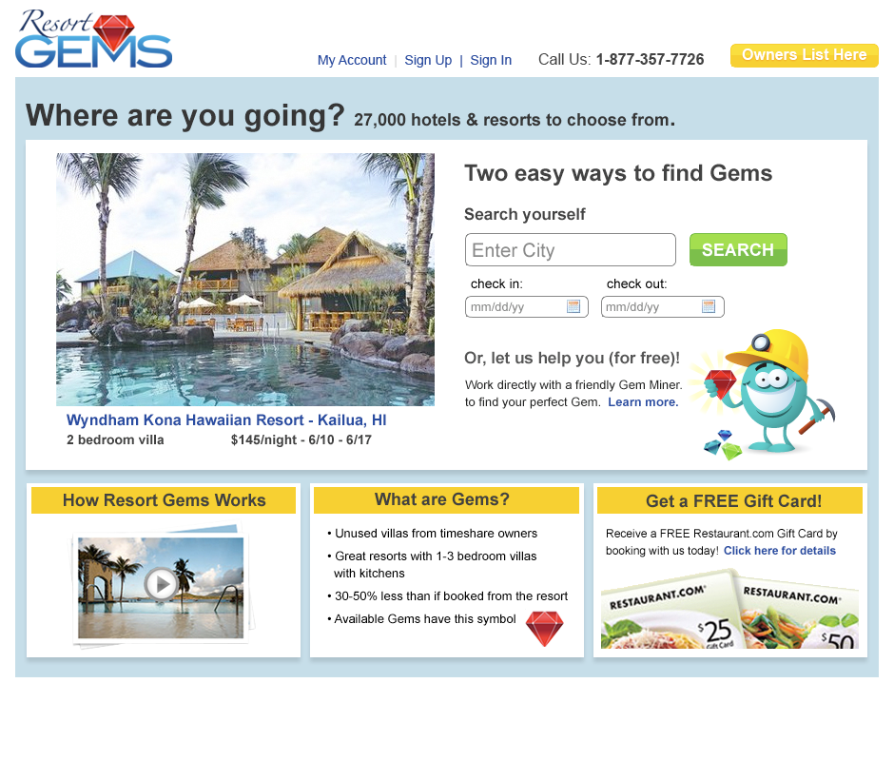
Notes:
We tried cleaner design, animated characters to engage the user, videos that explained how the site worked, and promotions in an attempt to get more people to rent. We were so certain in the basic idea that we could win with better features and design that we failed to consider fundamental problems. And the biggest of those was this - why when it was free to list your timeshare with us did so few people do it? We had critical assumptions in our business plan - that we had adequate supply of listings and that a free price point would encourage organic listings - and never bothered to validate them.

Slide 91
Product Development Model
Notes:
Although we made many attempts to iterate and learn from our mistakes, VacationView ultimately followed this path. And so, despite eventually having $1.1M in cash to use, we ultimately failed with this model. This likely remains the dominant way businesses are built today. But there are problems with it.
- Front loading so much of product development amounts to a “build in and they will come” mentality
- Sales and marketing costs are expended before we know if they will be effective
- The goal becomes shipping to the 1st customer
In short, there is a tremendous opportunity for waste

Slide 92

Notes:
In 2005 Steve Blank published a book that kicked off the modern lean startup movement. Although it took a while to gain an audience, it has been hugely influential.

Slide 93
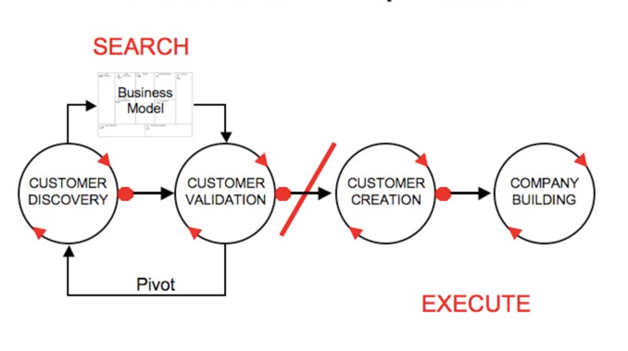
Customer Development Model
Notes:
The big idea in Steve’s book is to argue that there’s a better way than the product development model. And that’s the customer development model. We won’t cover all of it here today, but you can read his book to learn more. As you can see, there are four steps the the model. In this precompiler, we’re going to focus on the first.
Broadly speaking, Customer Discovery focuses on testing whether your business model is correct.
Customer Validation is for developing a sales model that can be replicated.
Customer creation is where you create and drive end-user demand.
And Company building is where you transition your organization to one where execution is as important as learning.

Slide 94
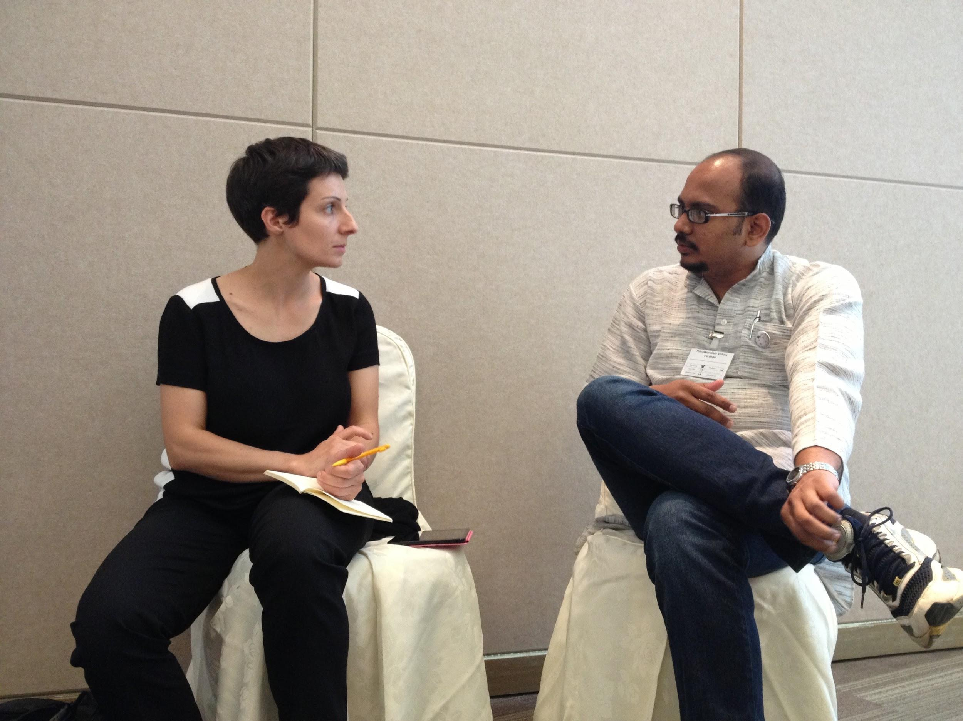
Customer Discovery
Notes:
OK, so let’s dive a little deeper on customer discovery

Slide 95
You’re not executing a business plan
You’re trying to find one
Notes:
Remember, in Customer Discovery, the focus is to test whether your business model is correct. In particular, we’re looking to see if your product solves the customer’s problems and needs.

Slide 96
“In a startup no facts exist inside the building, only opinions”
Notes:
As Gina talked about earlier, much of what we’ve done up to now is to highlight the assumptions our business is built on. It’s important to emphasize that these assumptions are merely opinions. Steve Blank says that inside the walls of your company, you only have access to opinions.

Slide 97
“Get Out Of The Building”
Notes:
To solve this and get facts, you need to get out of the building and talk to people.

Slide 98
Stealth
Mode
Notes:
It used to be fashionable for startups to operate in stealth mode while they developed their first product. The belief was that first mover advantage was so powerful that you had to be careful not to tip potential customers off to your plans. But customer feedback matters much more than secrecy. Basic ideas are plentiful. It’s unlikely yours is unique. What you need to know is which of your assumptions are valid and which are not.

Slide 99

You Are a Detective
Notes:
Think of yourself as a detective. You might have a hunch about who solved the crime, but you need evidence to back up your suspicions. A detective who arrests someone merely on the basis of suspicion and nothing else is going to be in for a rude awakening when they find out some of their assumptions turn out to have been wrong.

Slide 100

Notes:
If you’ve heard anything at all about lean methods, it’s likely to have been in reference to the using an MVP or “Minimally Viable Product”. But it’s largely misunderstood.

Slide 101
BUILD
LEARN
MEASURE
Notes:
If you’ve heard one thing about lean methods, it’s MVP. And if you’ve heard two, it’s probably that you follow a cycle referred to as build, measure, learn. There are countless debates about where you start this cycle. I would encourage you to think about what you want to learn first. Then build the simplest thing you can to get that learning and measure the results. The learn at the end of one cycle blends with the learn at the start of the next.

Slide 102
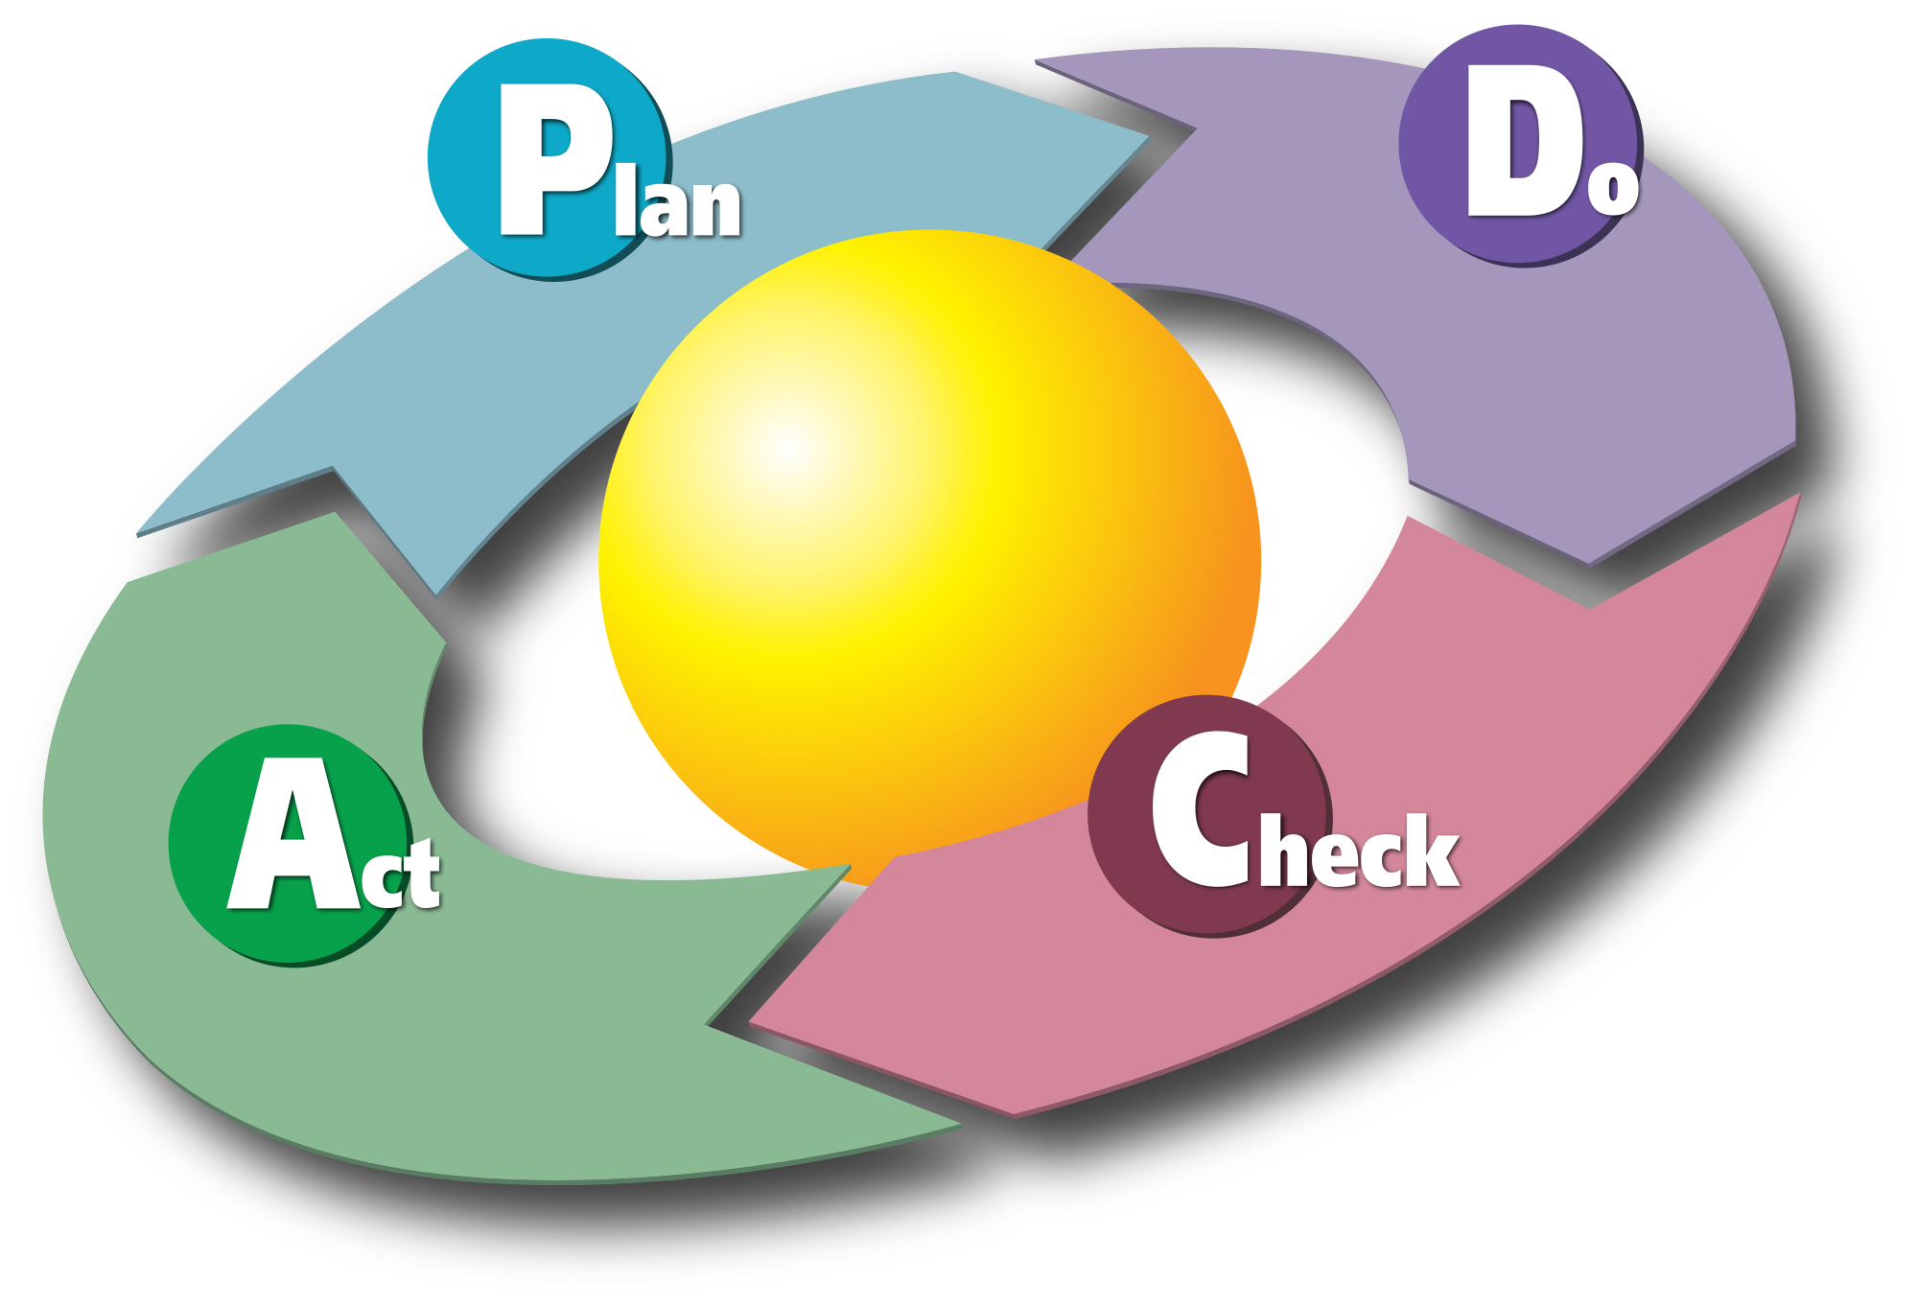
Notes:
A similar cycle is called Plan Do Check Act, from Edward Demming. While Build Measure Learn is the mantra in the lean startup world, PDCA dominates lean manufacturing.

Slide 103
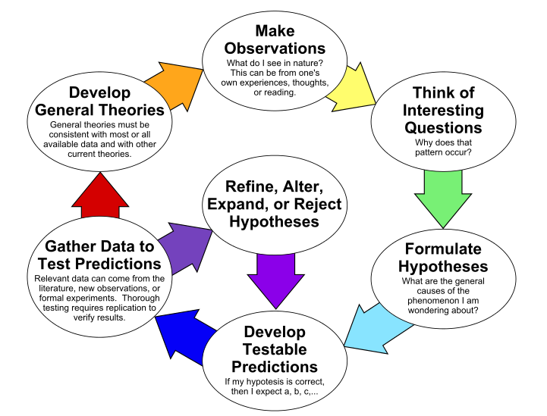
Source: https://en.wikipedia.org/wiki/File:The_Scientific_Method_as_an_Ongoing_Process.svg
Notes:
At some level, both are simplifications of the scientific method that has been developed over the centuries from Aristotle up through Isaac Newton. When you consider how long it took for this process to evolve, you realize we’re still in early days with thinking about how product development is done.

Slide 104
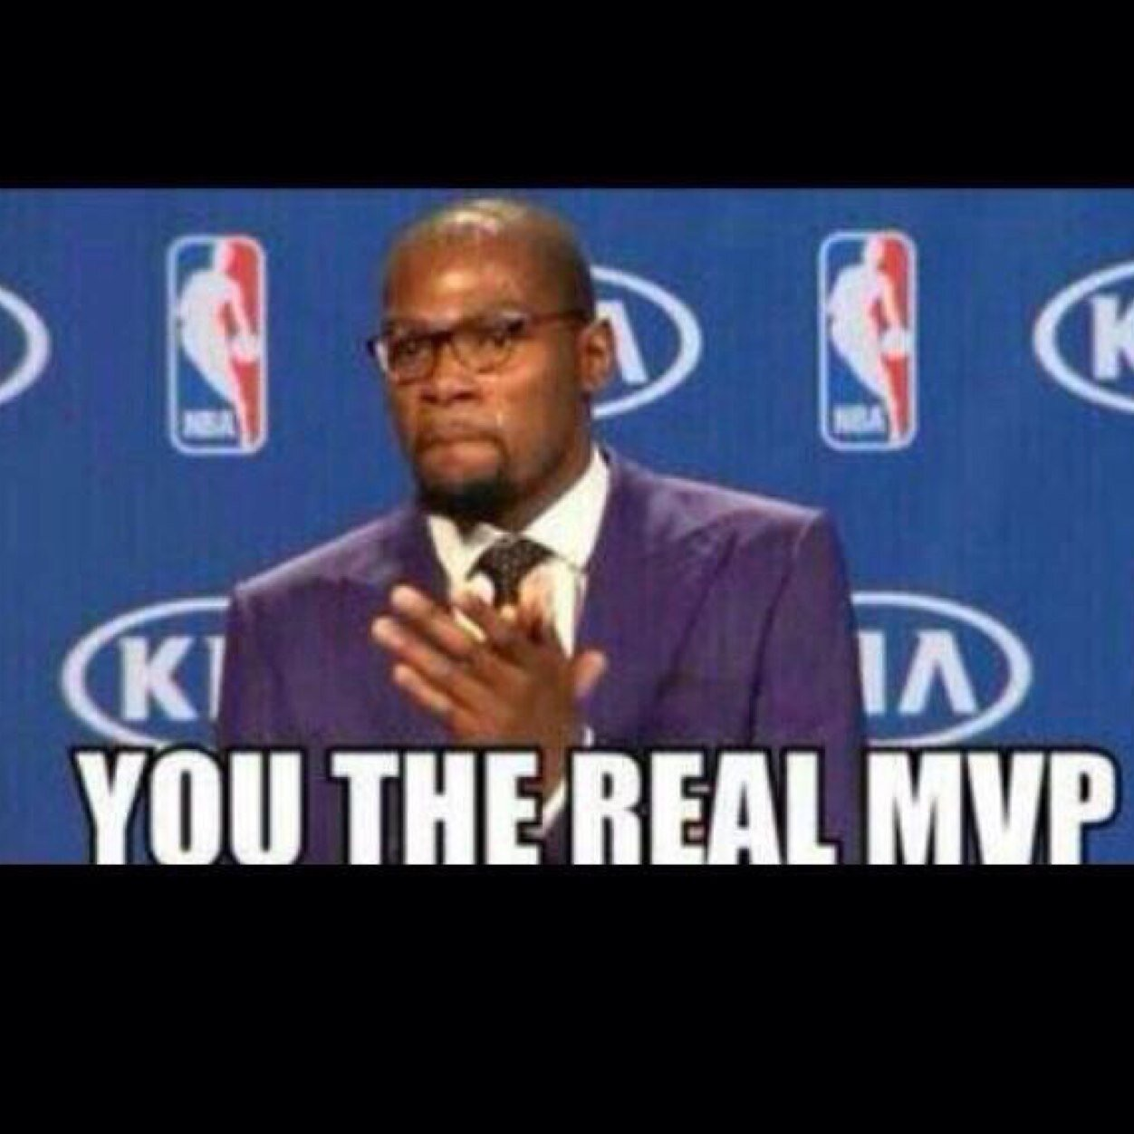
Notes:
So what is the real MVP then? Eric Ries describes it as something that helps you start the process of learning as quickly as possible. It’s not necessarily the smallest product imaginable. It’s simply the fastest way to get through the Build-Measure-Learn feedback loop with the minimum amount of effort.

Slide 105
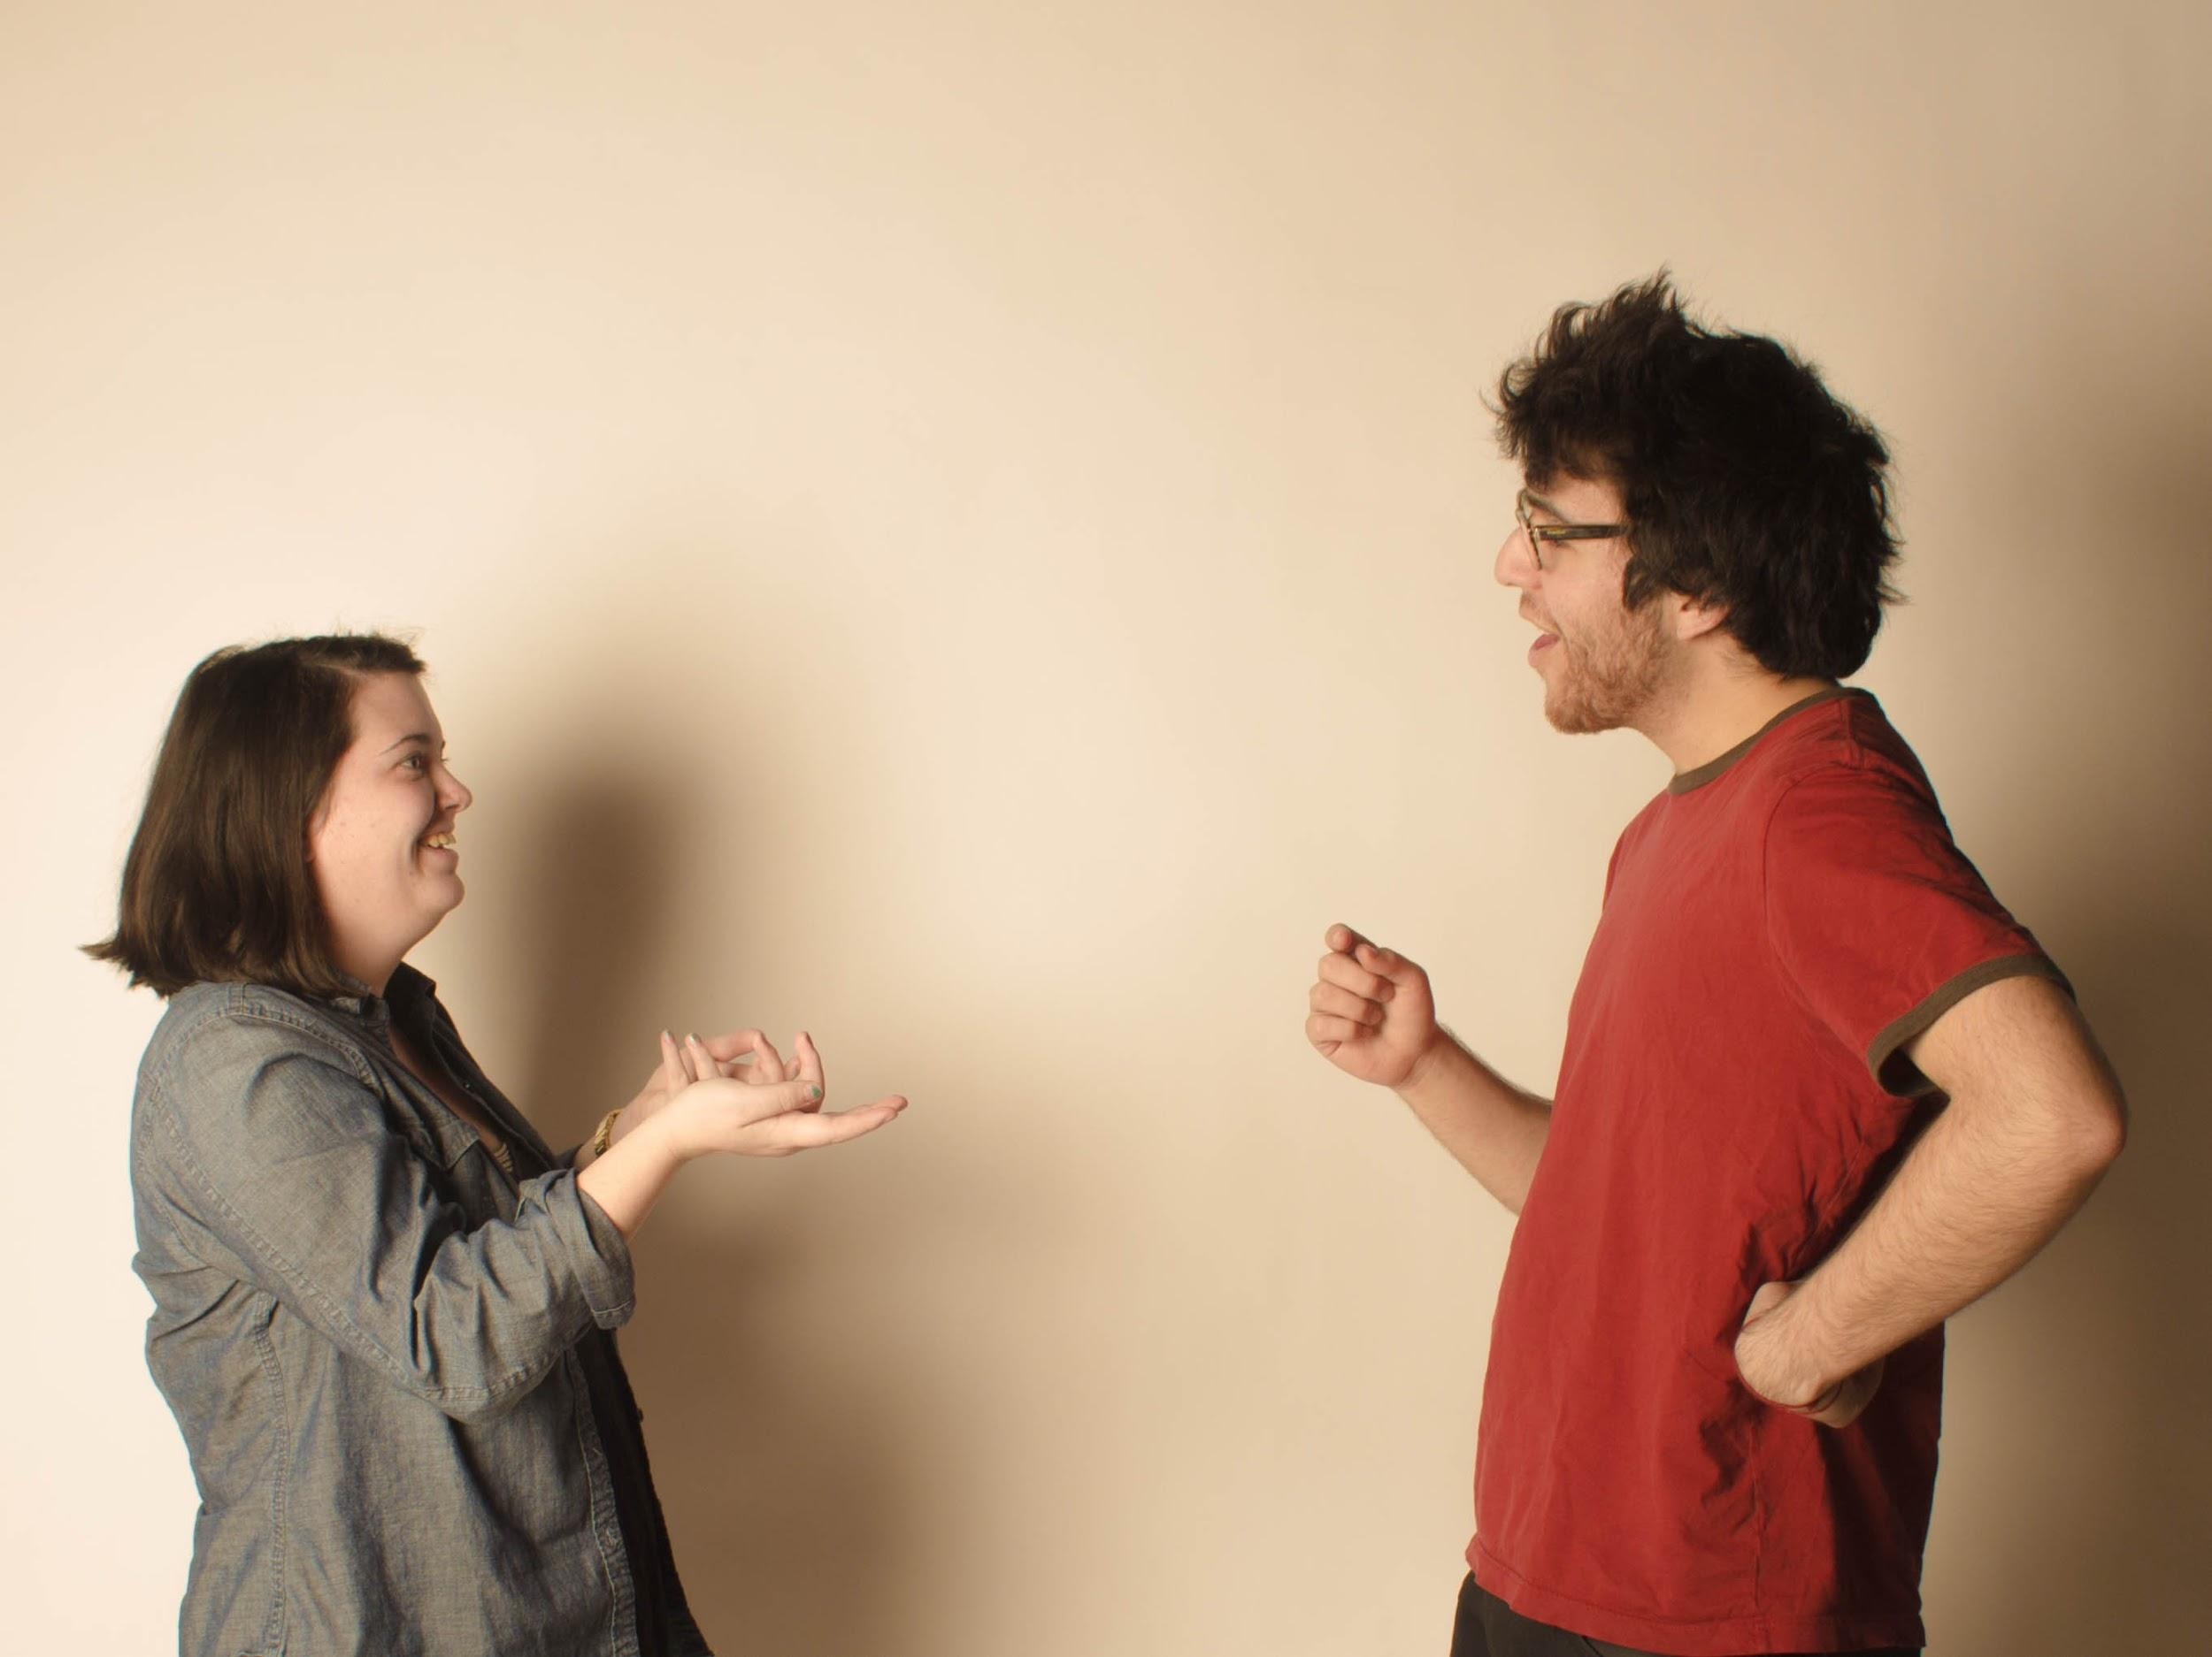
Talk to People
Notes:
The simplest thing we can do to start is to talk to people. If we do it right, we never stop this. Talking to customers is a critical form of feedback that any company should be doing constantly. But at the start, the simplest thing we can build that helps us learn is a set of questions to ask along with a few visual aids.

Slide 106
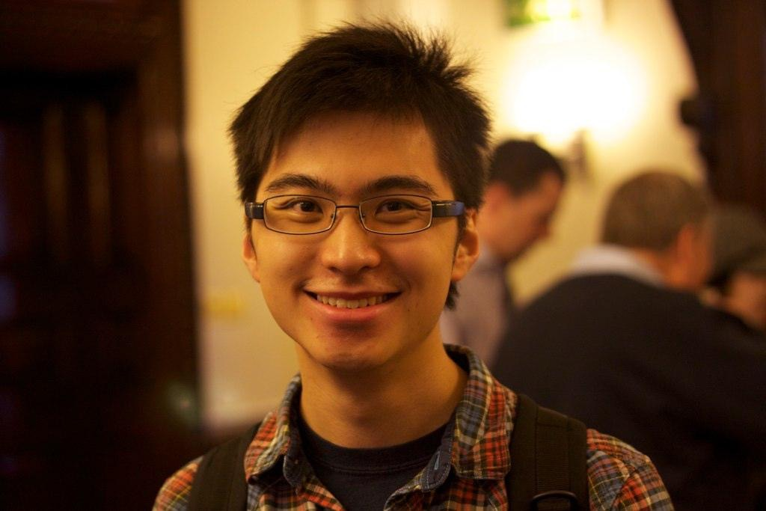
Typical Customer
Notes:
Be specific about how your typical customer is
Too many people think they’re typical customer is everyone
You probably shouldn’t start building for them, but having an assumption about who they will be is helpful

Slide 107
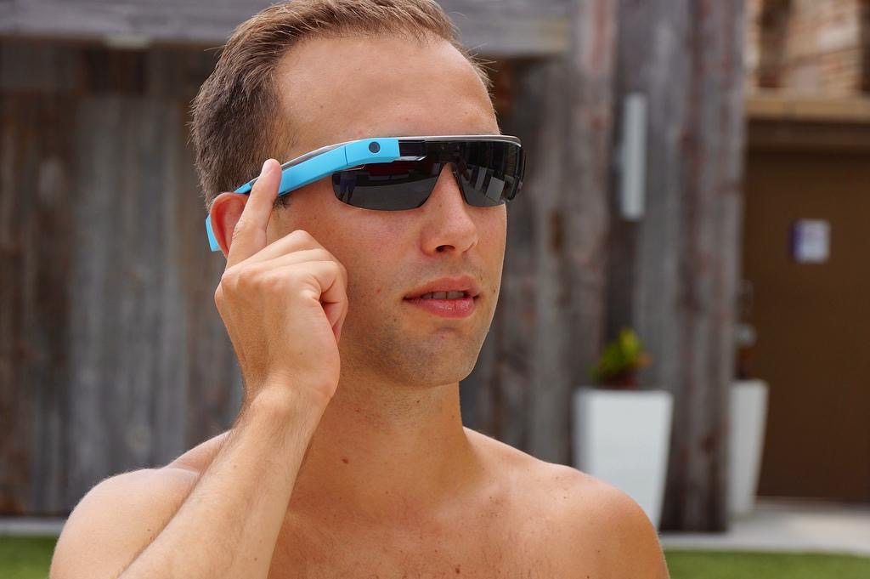
Early Adopters
Notes:
Who is going to use your product first?
You can pay too much attention to these people over the long term, but you have to be able to sell to them first.
These people are not your typical customer - they are enthusiasts. But they will help signal to you if there’s any hope at all.

Slide 108
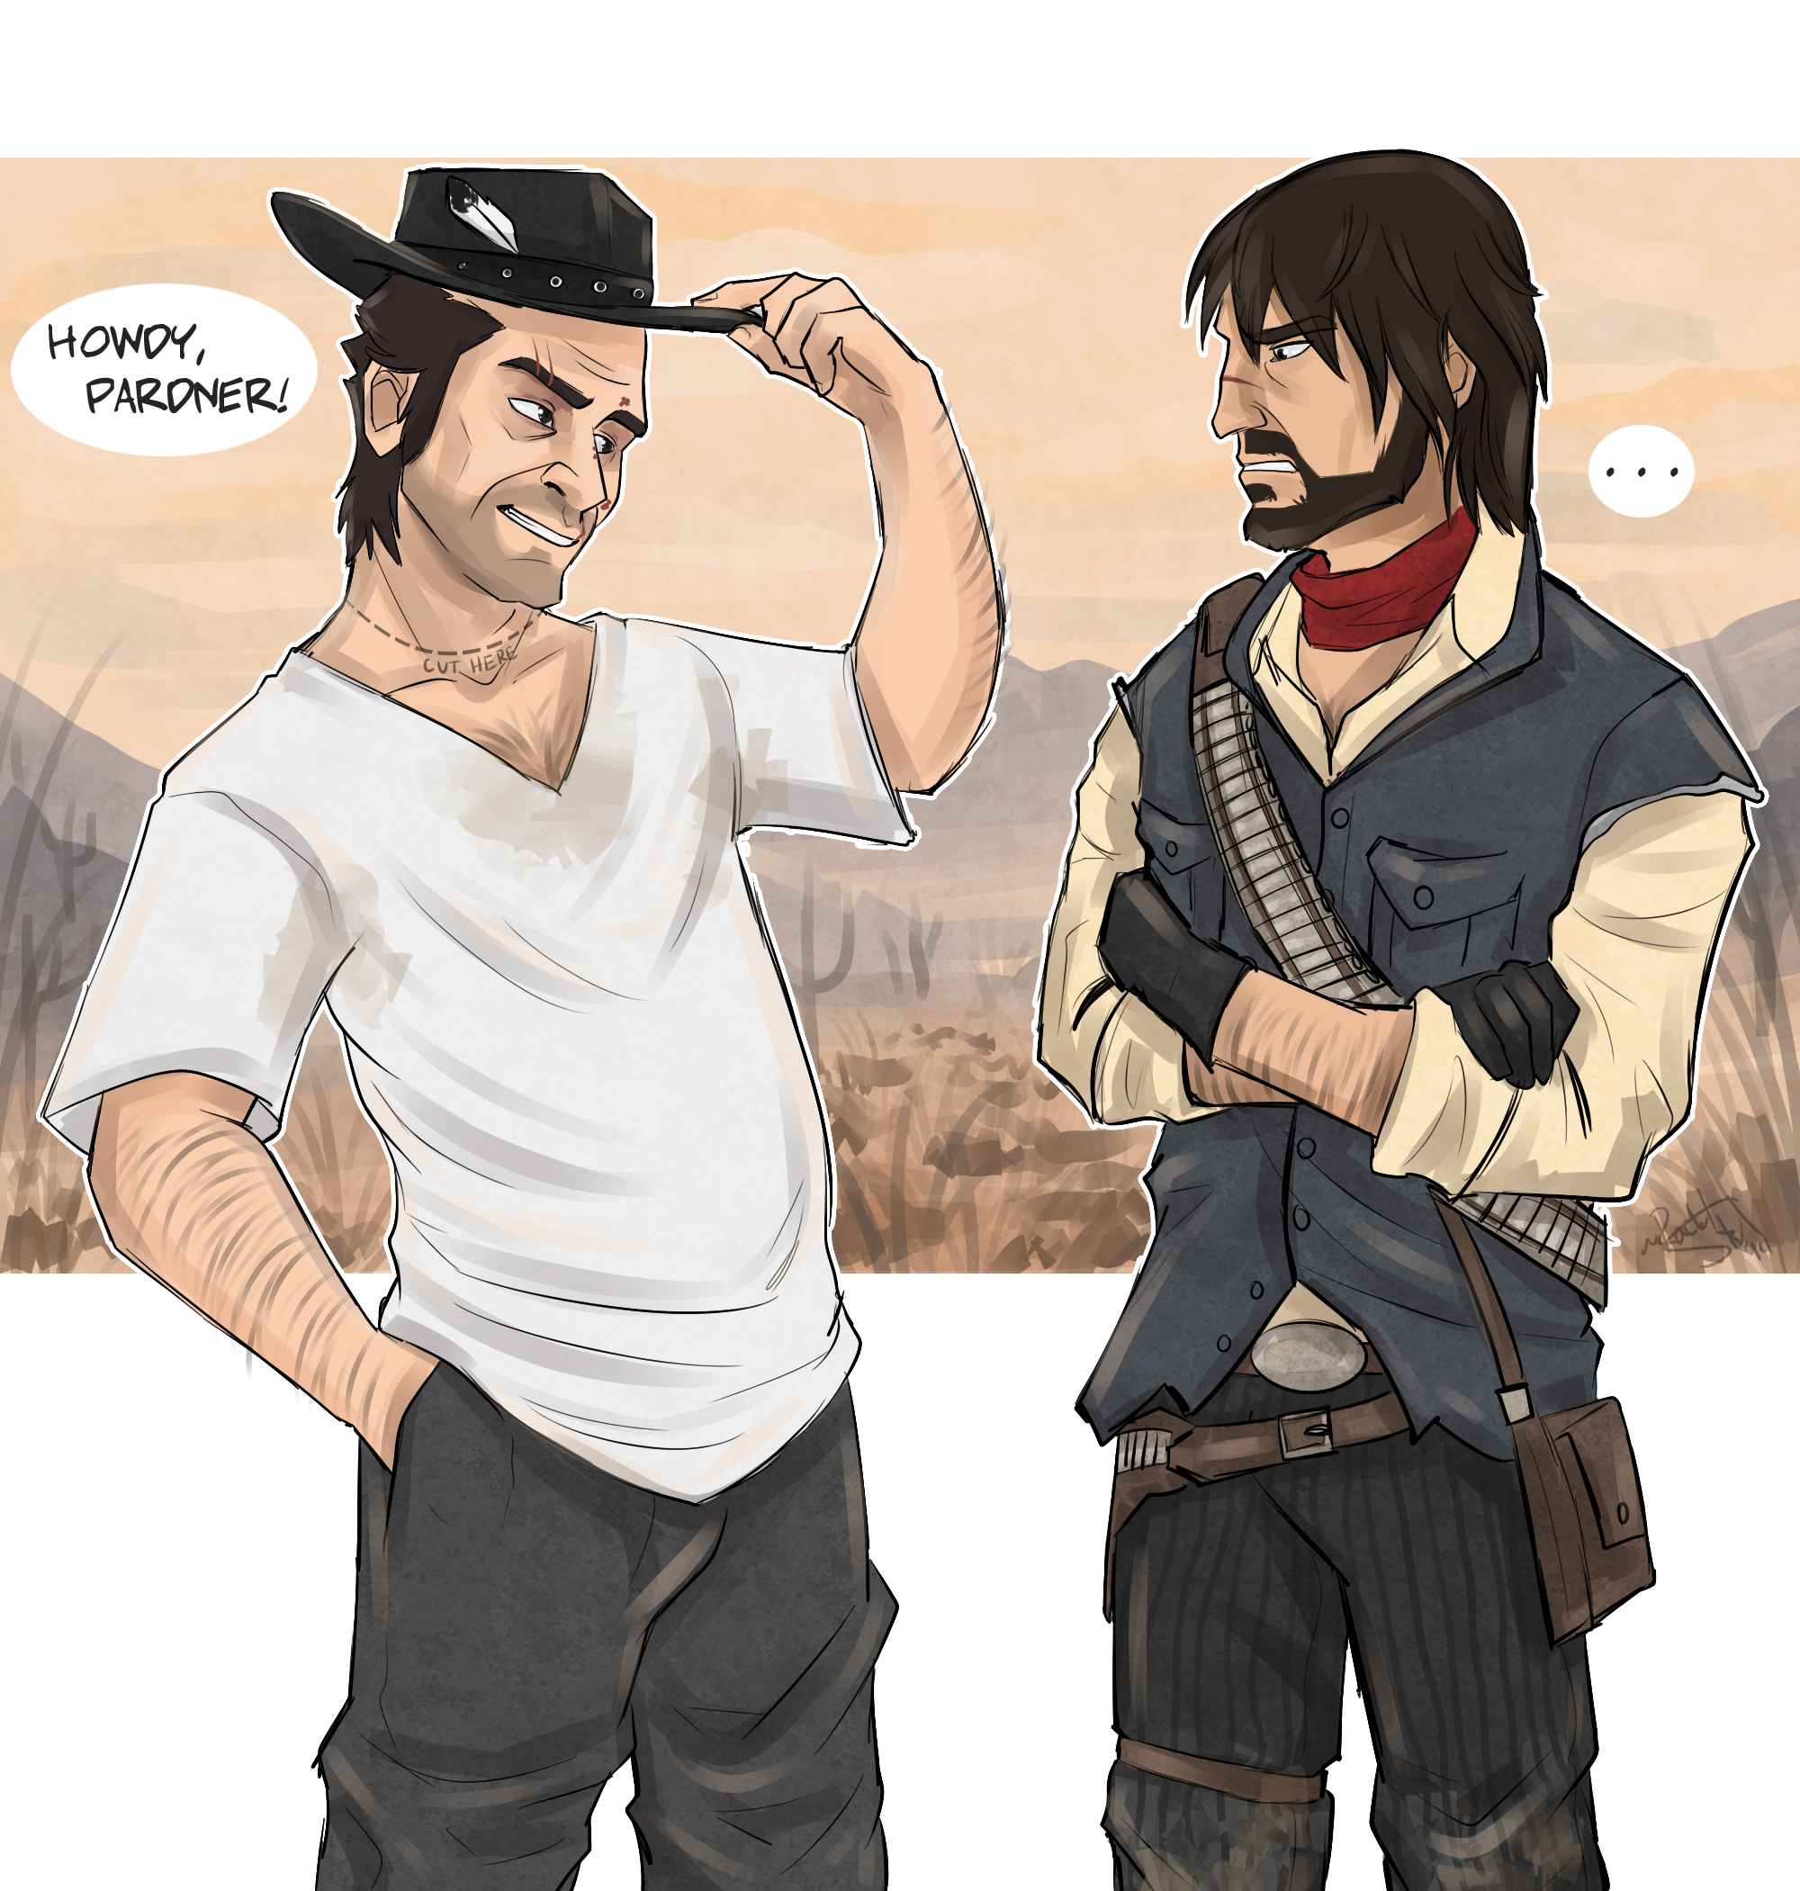
Potential Partners
Notes:
Beyond customers, who else do you need to work with to succeed?
suppliers
distributors
who will help you with customer acquisition

Slide 109

How Many?
Notes:
More than you probably expect
50-100 is a good start and easier to achieve than you might expect
Consumer applications require more than B2B/Enterprise applications

Slide 110

What To Learn
Notes:
Although the cycle is called “build measure learn”, it’s helpful to start thinking about what you want to learn first
An MVP is the simplest thing you can create to help you learn that

Slide 111

Riskiest Assumptions
Notes:
Refer back to risk assumptions exercise
Take small risks frequently rather than big risks
What, if I’m wrong, can kill my business?

Slide 112
Assumption Ranking
High
Danger
Zone
Impact
Low
High
Low
Confidence

Slide 113

Finding People

Slide 114

Fish Where The Fish Are
Notes:
Find the moment of pain to observe behavior and follow up with quick conversation
Where do your personas hang out and are approachable?
Dropbox started when Drew Houston posted screencast to Hacker News
Don’t fish where the fish are not

Slide 115

Degrees of Separation
Notes:
Your closest friends and family will be too willing to tell you what you want to hear instead of what you need to hear
At least one degree of separation

Slide 116

Be Creative
Notes:
Coffee shops are a good start but may be too unfocused
Don’t expect people to come to you, you’ll have to go to them
Giff’s example of a woman who bought women pedicures and wine as a gimmick to get women when they could be away from their kids ← kind of creepy to me, maybe a better example

Slide 117

Ask For Referrals
Notes:
At the end of the interview - “is there anyone else I should be talking to?”
Ask your friends who would be good people to talk to and get an introduction

Slide 118

Ask For Advice
Notes:
Distinguish from selling (“I’m not trying to sell you anything”)
Name drop to make it easier (e.g. “Jenny told me you are someone who is an expert in something I’m researching”)
Create a blog and ask them if you can interview them for the blog

Slide 119

Enterprise Customers
Notes:
LinkedIn
Conferences
Gatekeepers (e.g. executive assistant) who can either get you to the right person or get you a referral to someone else
Ask for Advice works here too

Slide 120

Being Effective

Slide 121

One Subject At A Time
Notes:
Group think

Slide 122

Make an Interview Plan
Notes:
it’s’ a guide not a script
warm up question to get them comfortable
main body of the interview
ask for referral
ask if you can follow up in later stages

Slide 123

Ask for Stories
Notes:
Tell me about the last time you met someone at a conference
How did you find a hotel room for this conference
When was the last time you decided you didn’t want to use your time share

Slide 124

Ask Open Ended Questions
Notes:
How do you decide what conferences to attend in a given year?
Who pays for the hotel room?
Questions that are not easily answered with a yes/no

Slide 125

Interview In Person

Slide 126

Have an Accomplice
Notes:
Take notes so you can focus on asking questions and listening
Accomplice is an observer - of both you and the subject

Slide 127

Listen, Don’t Talk
Notes:
You are not in sales mode here

Slide 128

Repeat/Restate to Confirm

Slide 129

Disarm Politeness Training
Notes:
People want to be nice to you. Ask them to be brutally honest.

Slide 130

Asking
About
Price
Notes:
Ask indirectly
“How much does this problem cost you today”
“What would you pay to make this problem go away”
Be extremely skeptical of the answers

Slide 131
Exercise - Customer Discovery Prep
Using your chosen hypothesis, create an interview plan designed to find the truth behind your assumptions.
Plan for 5-7 minute conversations.
Sketch a visual aid
15 minutes
One subject at a time
Make an interview plan
Ask for stories
Ask open ended questions
Interview in person
Use a note taker
Listen, don’t talk
Repeat/restate to confirm
Disarm politeness training
Ask price questions indirectly

Slide 132
Exercise - Interviews
Working in pairs, talk to at least 2 separate people.
Regroup to discuss what you learned.
30 minutes
One subject at a time
Make an interview plan
Ask for stories
Ask open ended questions
Interview in person
Use a note taker
Listen, don’t talk
Repeat/restate to confirm
Disarm politeness training
Ask price questions indirectly

Slide 133

Making Sense Of The Results

Slide 134

Dump and Sort

Slide 135

False Positives And Unclear Results

Slide 136

Both Qualitative And Quantitative
source: “Talking To Humans”

Slide 137

Human Judgment Required
source: David Bland

Slide 138
Exercise - Hypothesis Adjustment
Review your hypothesis in light of what you have learned.
Create a new hypothesis
How does your product change?
10 minutes

Slide 139
Lunch!
Start again at 1pm

Slide 140
Design Studio

Slide 141
DESIGN STUDIO
DESIGN CHARRETTE

Slide 142
Notes:
Little Cart
Ecole Des Beaux-Arts in Paris

Slide 144


Slide 145


Slide 146
CREATE. PITCH. CRITIQUE.

Slide 147
Todd Zaki Warfel’s
6.8.5

Slide 148
Butcher Paper
Letter Paper
Painter’s Tape
Sharpies
Stop Watch

Slide 149
CO-CREATION

Slide 150


Slide 151
DESIGNER AS
FACILITATOR

Slide 152
CROSS-FUNCTIONAL
TEAMS

Slide 153
CREATE.
Notes:
6-8 concept sketches individually.
Just enough design

Slide 154
Notes:
6-8 concept sketches individually.
Just enough design

Slide 155
CREATE. PITCH.
Notes:
3 minutes to pitch
What part of the scenario
What were your goals
How my design addresses those goals

Slide 156
CREATE. PITCH. CRITIQUE.
Notes:
2 minutes to critique
This isn't feedback—I like / don't like
Your critique is based on the persona and the goals
2-3 ways it accomplished the goals
1-2 ways it could be better

Slide 157
STEAL!

Slide 158
WHY?
Notes:
Level-sets playing field
Idea Generation
Vetting Design Concepts
Team Buy-In — ownership / investment

Slide 159
Story Mapping

Slide 160

Notes:
There’s a problem with how we define software.

Slide 161
A Brief Story
Notes:
I want to tell you a short story about myself. It begins on March 22, 2014. I was at my house when suddenly my right leg went numb. At first I thought it might just be asleep, but I soon realized it wasn’t. I went to an urgent care center to get checked out, telling them that I was worried that I was having a stroke. They did a CAT scan on me there and immediately transported me to Riverside Methodist Hospital by ambulance. Most of the rest of that night was a blur, but at some point they performed an MRI on me.

Slide 162

Notes:
Early the next morning, I was told I had a low grade brain tumor.

Slide 163

Notes:
On May 8, I was scheduled for surgery to have it removed.

Slide 164

Notes:
A few weeks after surgery, I went through a six week course of radiation

Slide 165

Notes:
I also went on chemo therapy for a year.

Slide 166

Notes:
I now get checked for new growth by getting an MRI every 4 months. In fact, I just joined the double digit club with my 10th MRI just yesterday. This is not a club you want to be in. Fortunately, all of my scans have come back showing things are stable. The white spot you see there is scar tissue left over from the surgery.

Slide 167
The End
Notes:
So there, in just a couple of minutes, you know pretty much all you need to know at the high level about what my health situation has been like over the last two years. Of course, there’s much more to the story than that however.

Slide 168

Notes:
For example, I could tell you that the story doesn’t really begin on March 22, 2014. The story really begins in January of 2002 when out of the blue my mom suffered a grand mal seizure that was brought on by a much more aggressive brain tumor that would kill her in under a year. I could also tell you that I suffered a 4 minute grand mal seizure after the ambulance took me from the urgent care center to the hospital.

Slide 169

Notes:
I ran a half marathon 5 days before my surgery and had a mini-seizure about two miles into the run.

Slide 170

Notes:
And did you know before going into brain surgery, they initial the side they’re going to cut on so they don’t get the wrong side?

Slide 171

Notes:
Also, on the day of the surgery, I was told that the MRI they did on me that day made them very worried that it was in fact a high grade tumor that might mean I had only a year to live. I would have to wait 5 days to hear the results.

Slide 172

Notes:
And, I have the most bad-ass scar of anyone in the room.

Slide 173

Notes:
And when you get radiation, your head gets bolted down by this terrifying mask that makes it impossible to move.

Slide 174

Notes:
And maybe the happiest day along the way was the day I got to drive again after being forced off the road by my seizure for six months.

Slide 175

Notes:
And now you know, the rest of the story. Except you really don’t. I could provide many additional layers of detail that flesh out the complete tale. And if you catch me after the session is done, perhaps I will.

Slide 176
Effective Story Telling
Stories with pictures instead of documents
Don’t over specify
Care more about highlighting surprises than detailing the obvious

Slide 177

Notes:
If you’ve done any form of agile development at all, you’ve no doubt been exposed to working with User Stories. A few years ago, Jeff Patton pioneered a method of using stories together into a map.

Slide 179


Slide 180

Notes:
Here’s an example of a story map for the story I told you. Time generally flows linearly in these, but that need not be the case if you have a more complex interaction to describe.
Your map, like your product, has a backbone that supports the details. You begin by thinking of the simplest tale that can cover that backbone.
Subsequent iterations can provide a more complete picture, but you’re better off figuring out if people even care before investing more time.

Slide 181


Slide 182
Exercise - Story Mapping
Create a story map for your product using post-it notes.
Divide details up into at least two releases separated by tape.
Prepare to tell us the story of how your product gets used with the first release and what you are hoping to learn.
30 minutes

Slide 183
Wrap-up

Slide 184
What To Take Away
Talking to people doesn’t have to hurt.
To build the right thing, start by not building the whole thing.
There’s a process to identifying the right features.
Developers, Designers, and Product Managers all have a role to play on a balanced team.

Slide 185
Recommended Reading
“Four Steps to the Epiphany” - Steve Blank
“The Lean Startup” - Eric Ries
“Running Lean” - Ash Maurya
“User Story Mapping” - Jeff Patton
“Lean From The Trenches” - Henrik Kniberg
“Talking to Humans” - Giff Constable
https://github.com/mdoel/presentations/tree/master/codemash_2016
Notes:
Mike authors this section:
Lecture (15 minutes)
Summary of lessons learned
How we used Lean to prepare this presentation
Resources for future use

Slide 186
Q&A

Slide 187


Want More?
Get in touch.
gina@mutuallyhuman.com
@ginawinkler
samuel@mutuallyhuman.com
@shmuel
mike@mutuallyhuman.com
@mikedoel

